Slide 1
Adoption of the Modified School Forms (SFs) for Public Elementary and Secondary Schools Effective End of School Year 2013-2014
MARIA NOEMI M. MONCADA, Ed.D., LI.B.
Member, DepEd Team

Slide 2
The utilization of the modified forms will allow all public school teachers and school heads to focus on the core business of curriculum delivery

Slide 3
List of Forms to be Replaced and Modified School Forms (SFs)

Slide 4
By SY 2014-2015, all public schools must use all seven modified school forms replacing the 16 previous school forms as shown in the Table.

Slide 5
It is very important to ensure that data to be reflected in the forms are consistent with the data encoded into the Enhanced Basic Education Information System (EBEIS), and into the Learner Information System (LIS). The cut off period for recording the Beginning of the School Year (BoSY) Reports in all the SFs will be every Friday of the first week of classes of each SY. School heads will be held accountable and liable for any deliberate wrongful entry on the forms.

Slide 6
As an interim strategy and until such time when the LIS and Human Resource Information System (HRIS) are fully operational, the SFs templates in MS Excel Spreadsheet format are available for download through the DepEd website: http://www.deped.gov.ph/index.php/resources/school-forms. Also available in the site is an instructional video on the use of the new school forms.

Slide 7
Immediate dissemination of and strict compliance with this Order is directed.

Slide 8
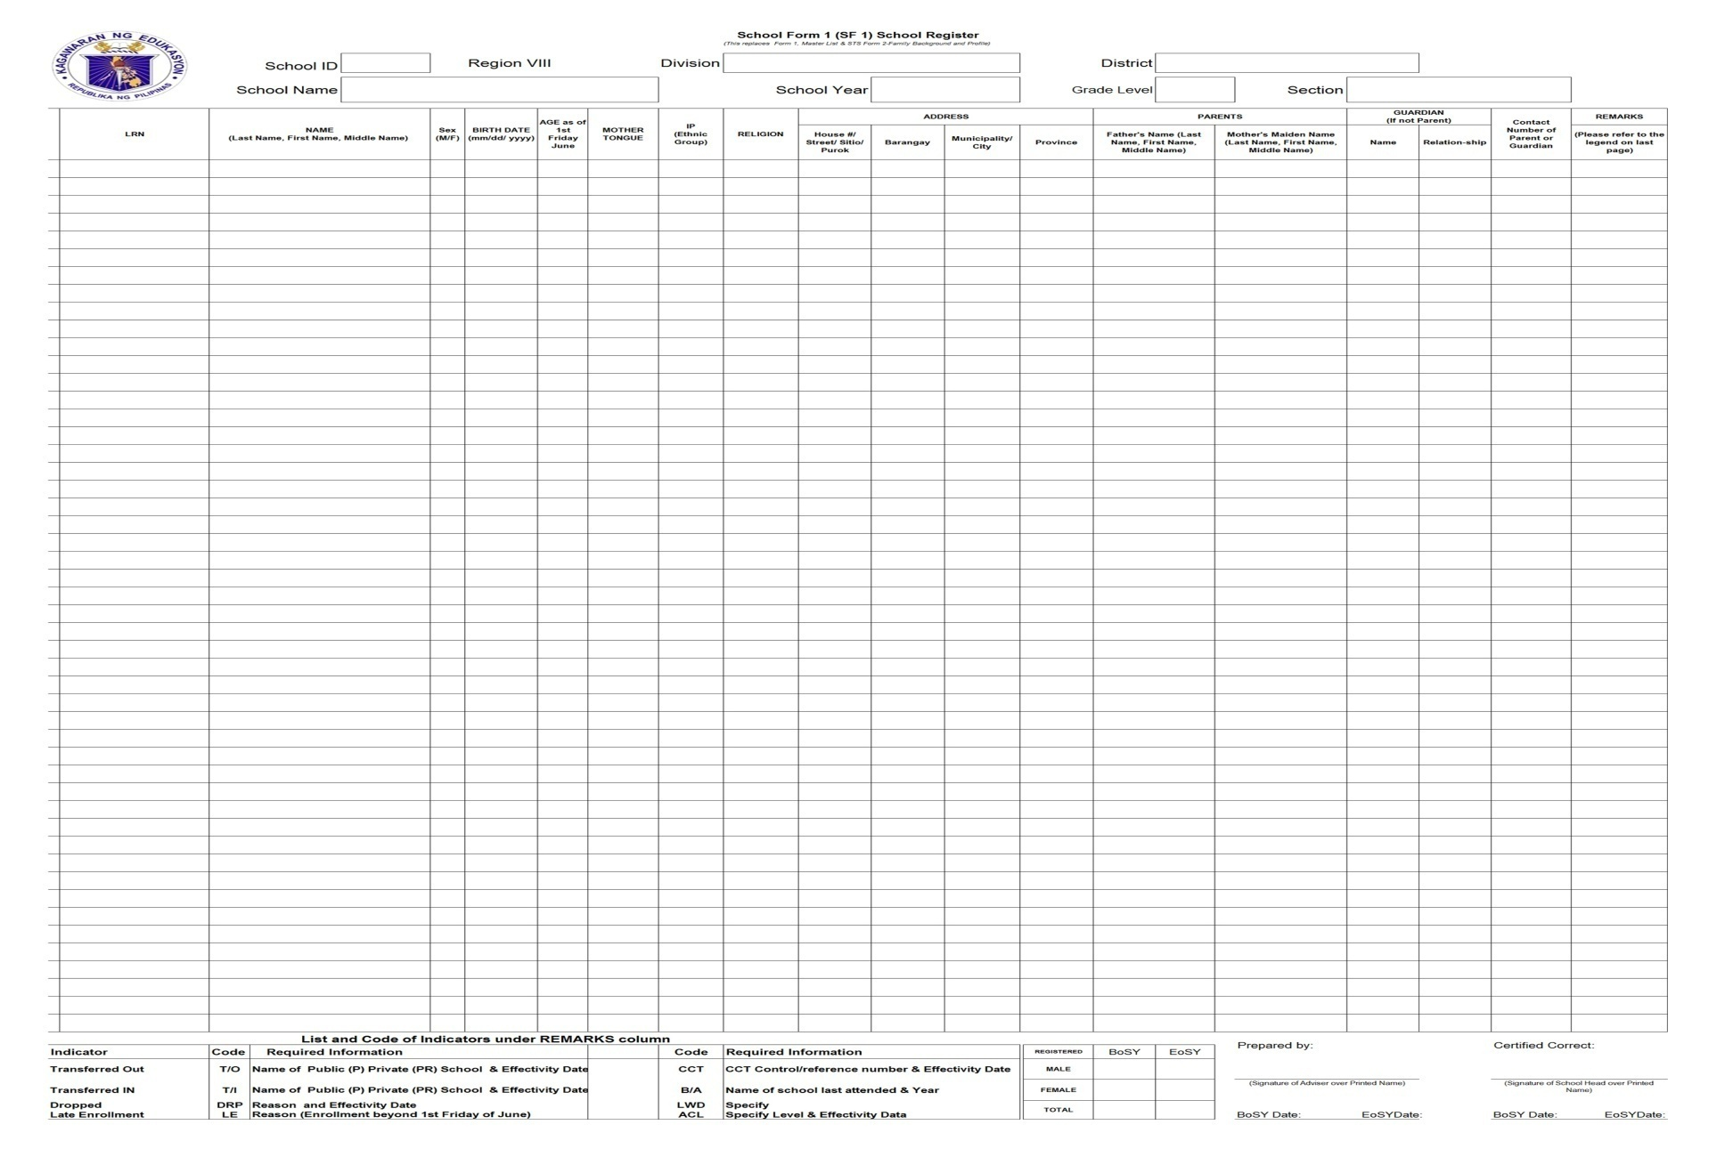
School Form 1 (SF1) School Register (This replaced Form 1 Master list & STS Form 2-Family Background and Profile)

Slide 9
SCHOOL FORMS Data Element Descriptions SF 1- School Register
 | DATA ELEMENT | DESCRIPTION
1 | School ID | A six (6) digit-number assigned to a school recognized in EBEIS
2 | School Year | The prescribed period of time when schools offer daily instruction. It covers10 months of regular schooling starting month of June (Beginning of School Year) up to the month of March (End of School Year) of the following year.
3 | School Name | Official name of school as registered in DepED and EBEIS
4 | Grade Level | A degree/stage of a learner classified according to age and progress.

Slide 10
SCHOOL FORMS Data Element Descriptions
 | DATA ELEMENT | DESCRIPTION
5 | Section | A group of pupils/students convened together to receive instruction in a given course or subject.
6 | Learner Reference Number (LRN) | Twelve (12)-digit number which the pupil, student or learner shall keep while completing the basic education program, regardless of transfer to another school or learning center in the public or private sector, and promotion/moving up to the secondary level. (DO22, s.2012)
7 | Name of Learner | Name of an individual as reflected in the birth certificate or equivalent document seeking basic literacy and functional life learning skills.
8 | Sex (Male or Female) | Learner's biological and physiological sex as reflected in the birth certificate or equivalent document.

Slide 11
SCHOOL FORMS Data Element Descriptions
 | DATA ELEMENT | DESCRIPTION
9 | Birth Date | Date of birth of the learner as reflected in the birth certificate or equivalent document.
10 | Place of Birth (Province) | The name of province where the learner was born as reflected in the birth certificate or other equivalent document.
11 | Age by June (1st Friday) | The actual age in years of a learner as of last birthday by the 1st Friday of each school calendar year.
12 | Mother Tongue | The language first learned by a learner; There are 19 major languages identified in the recent DepEd Orders which are: Tagalog, Kapampangan, Pangasinense, Iloko, Bikol, Cebuano, Hiligaynon, Waray, Tausug, Maguondanaoan, Maranao, Chabacano, Ybanag, Ivatan, Sambal, Aklanon, Kinaray-a, Yakan, and Surigaonon. (DO 16, s. 2012 & DO 28, s. 2013)

Slide 12
SCHOOL FORMS Data Element Descriptions
 | DATA ELEMENT | DESCRIPTION
13 | IP (Specify ethnic group) | A group of people or homogenous societies identified by self-ascription and ascription by others, who have continuously lived as organized community on communally bounded and defined territory.
14 | Religion | The religious belief of the learner. For Muslim leaners, “Islam” will be written instead of Muslim under this column.
15 | House #/Street | Refer to the place/location where the learner currently holds residence.
16 17 18 | Barangay Municipality Province

Slide 13
SCHOOL FORMS Data Element Descriptions
 | DATA ELEMENT | DESCRIPTION
19 | Name of Father | The name of father of the learner as reflected in the birth certificate or equivalent document.
20 | Name of Mother | The name of mother of the learner as reflected in the birth certificate or equivalent document.
21 | Name of Guardian | The person who oversees the welfare of the learner in behalf of the parents.
22 | Relationship to Guardian | The relationship between the learner and the guardian.
23 | Contact Number (of Parents/Guardian) | Contact number of the parents and/or the guardian of the learner.
24 | Remark/s | Additional information about the learner’s status or particular condition

Slide 14
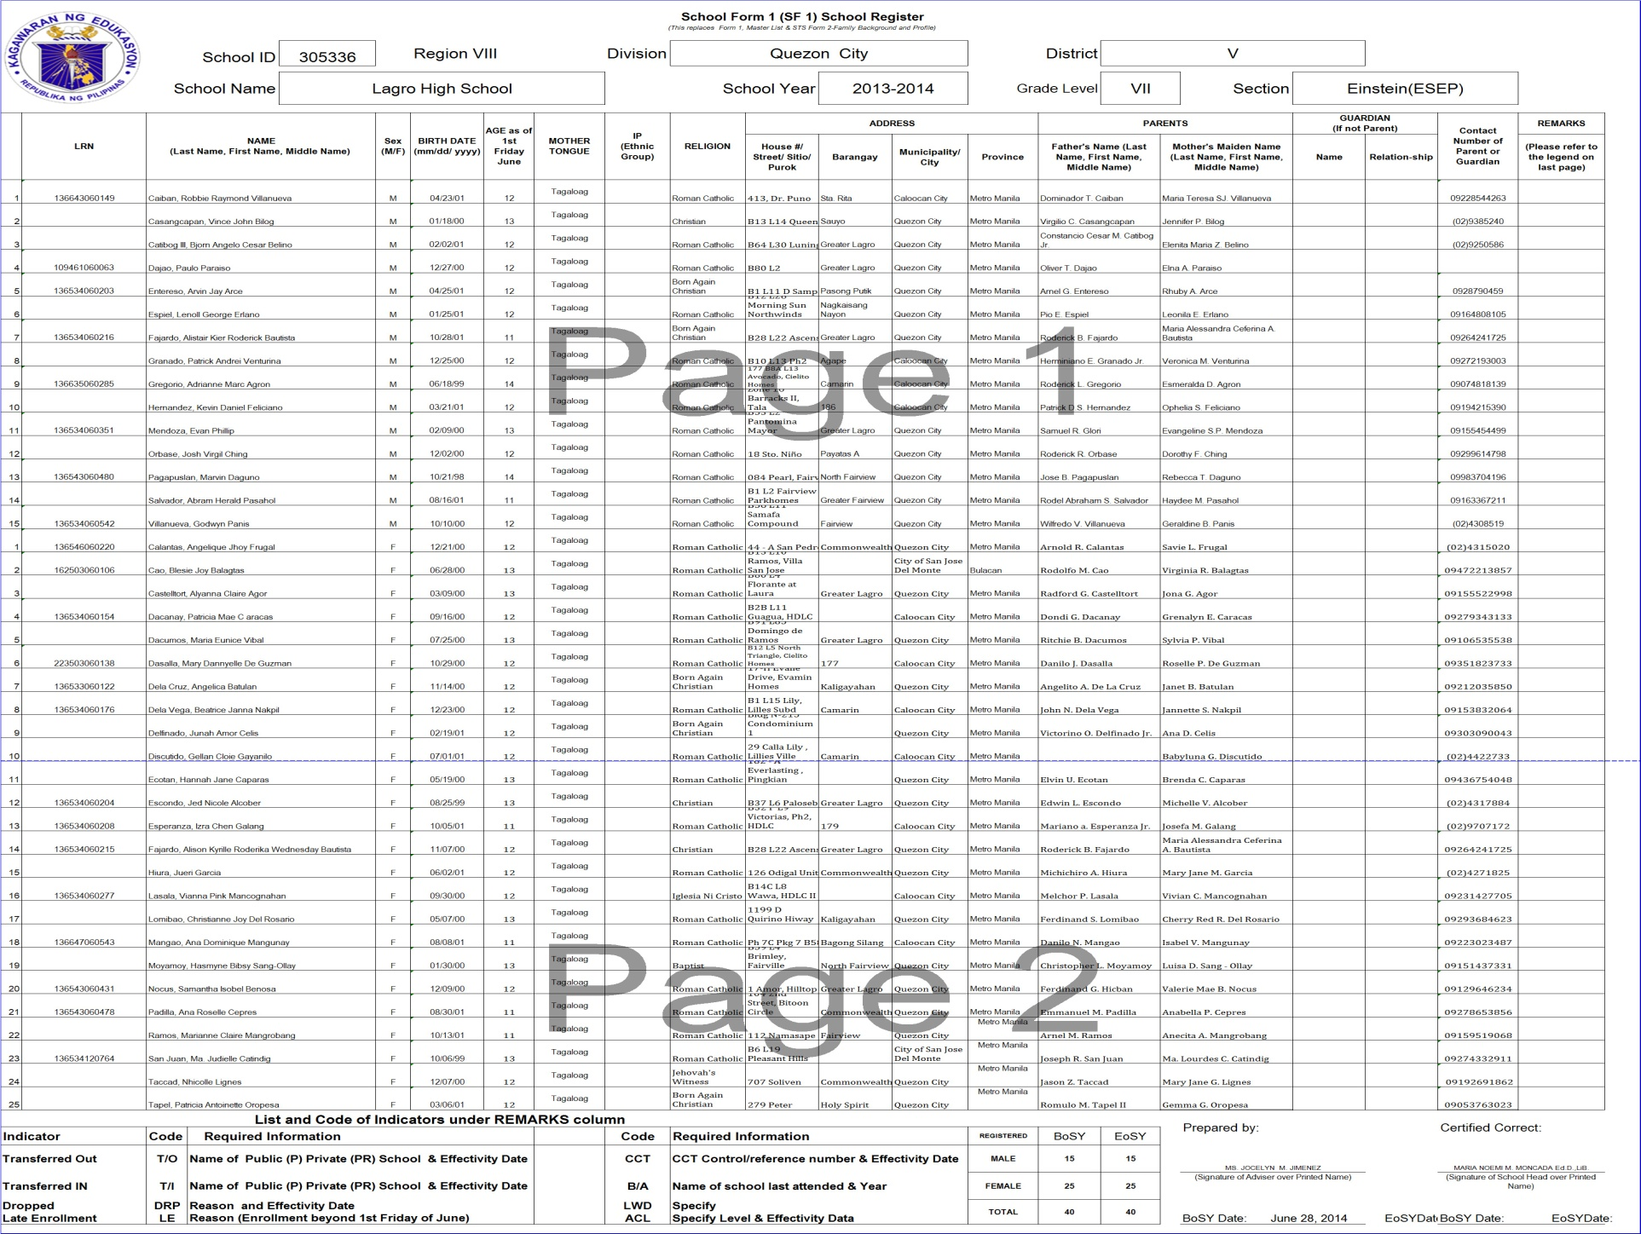

Slide 15
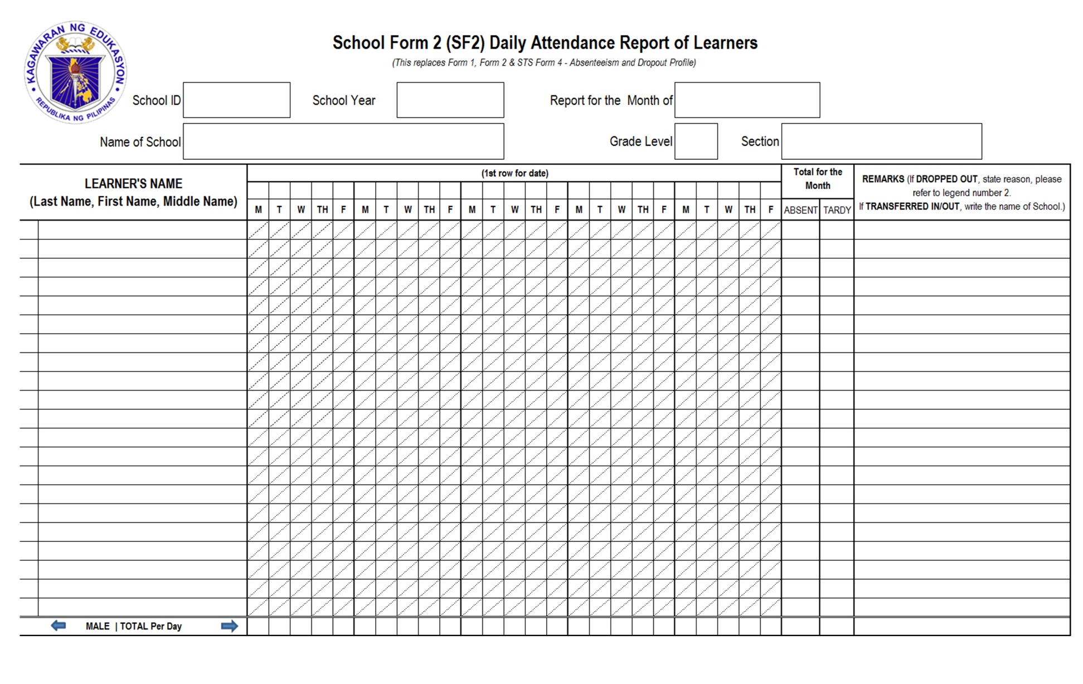
School Form 2 (SF2) Daily Attendance Report of Learners (This replaces Form 1, Form 2, & STS Form 4- Absenteeism and Dropout Profile)

Slide 16
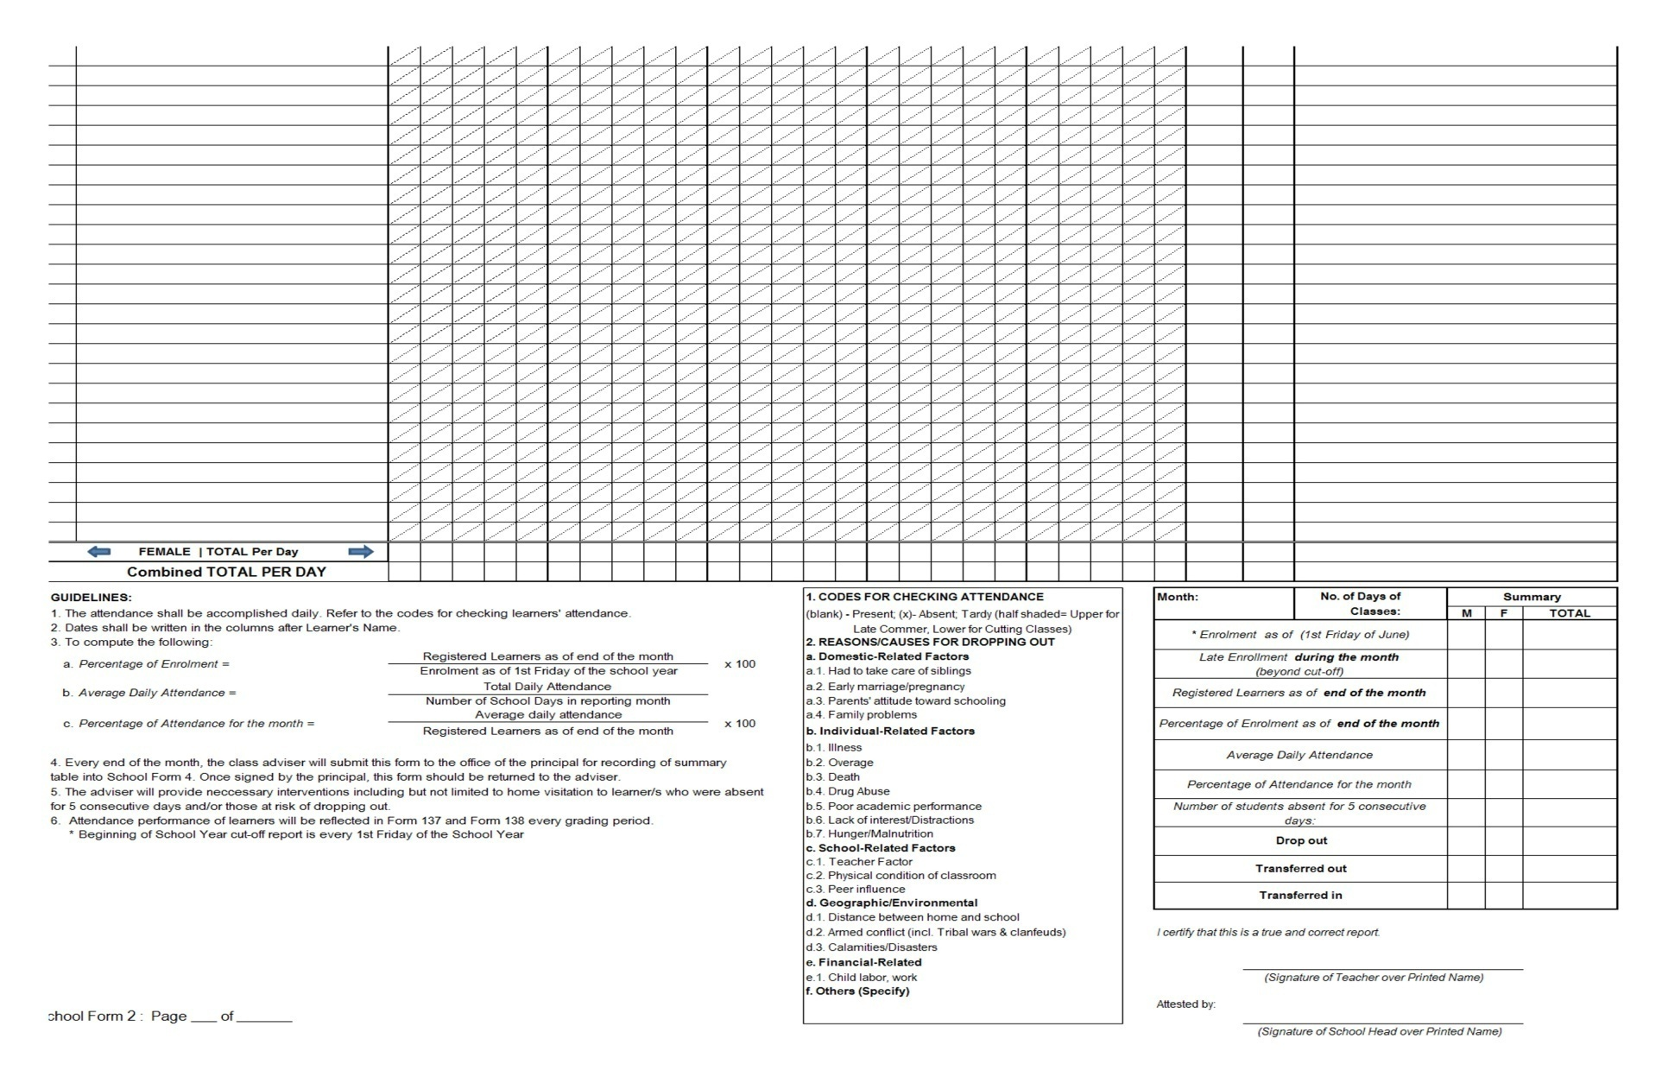
School Form 2 (SF2) Daily Attendance Report of Learners (This replaces Form 1, Form 2, & STS Form 4- Absenteeism and Dropout Profile)

Slide 17
SCHOOL FORMS Data Element Descriptions SF 2- Daily Attendance Report of Learners
 | DATA ELEMENT | DESCRIPTION
1 | School ID | A six (6) digit-number assigned to a school recognized in EBEIS
2 | School Year | The prescribed period of time when schools offer daily instruction. It covers10 months of regular schooling starting month of June (Beginning of School Year) up to the month of March (End of School Year) of the following year.
3 | School Name | Official name of school as registered in DepED and EBEIS
4 | Grade Level | A degree/stage of a learner classified according to age and progress.

Slide 18
SCHOOL FORMS Data Element Descriptions SF 2- Daily Attendance Report of Learners
 | DATA ELEMENT | DESCRIPTION
5 | Section | A group of pupils/students convened together to receive instruction in a given course or subject.
6 | Month | Month covered in the report
7 | Learner's Name | Name of the individual as reflected in the birth certificate or equivalent document.
8 | Date (Daily) | School day (Monday, Tuesday, Wednesday, Thursday and Friday) and date in month being reported.

Slide 19
SCHOOL FORMS Data Element Descriptions SF 2- Daily Attendance Report of Learners
 | DATA ELEMENT | DESCRIPTION
9 | Total number of Days Absent (per pupil) | Total number of absences of each learner in the month reported.
10 | Total number of Days Tardy (per pupil) | Total number of times a learner was late or spent less than the required time in school (under time including cutting of classes) during the month being reported.
11 | Remark/s | Additional information about the learner’s status or particular condition
12 | Enrolment as of 1st Friday of June | The total number of enrolled learners as of 1st Friday of June

Slide 20
SCHOOL FORMS Data Element Descriptions SF 2- Daily Attendance Report of Learners
 | DATA ELEMENT | DESCRIPTION
13 | Late Enrolment | Learners who reported to school beyond the cut-off of BoSY. This reflects only the number of late enrollees during the month being reported and not the cumulative total.
14 | Registered Learner as of end of the month | The actual number of learners who are officially enrolled and registered (including transferred in) as of the last day of classes for the month being reported. Learner/s who are dropped/transferred out during the month or prior the last day of classes for the month must not be added.

Slide 21
SCHOOL FORMS Data Element Descriptions SF 2- Daily Attendance Report of Learners
 | DATA ELEMENT | DESCRIPTION
15 | Percentage of Enrolment (registered learner as of end of the month over Enrolment as of July 31) | Registered Learners as of end of the Month The percentage (%) of the number of registered learners with a computation of: Registered Learners as of end of the Month Percentage of Enrollment = ------------------------- x100 Enrollment as of 1st Friday of June

Slide 22
SCHOOL FORMS Data Element Descriptions SF 2- Daily Attendance Report of Learners
 | DATA ELEMENT | DESCRIPTION
16 | Average Daily Attendance | The average daily number of learners attending classes during the month being reported Total Daily Attendance Average Daily Attendance ------------------- Number of School Days in reporting month

Slide 23
SCHOOL FORMS Data Element Descriptions SF 2- Daily Attendance Report of Learners
 | DATA ELEMENT | DESCRIPTION
17 | Percentage of Attendance for the month | The percentage of the attendance for the current month with a computation of: Total Daily Attendance Percentage of Attendance = ----------- x100 for the Month Registered Learner as of end of the Month

Slide 24
SCHOOL FORMS Data Element Descriptions SF 2- Daily Attendance Report of Learners
 | DATA ELEMENT | DESCRIPTION
18 | Number of students with 5 consecutive days of absences | Total number of learners who did not attend class for 5 consecutive days which can be used as basis for home visitation
19 | Drop out (M/F/Total) | Total Number of learners aggregated by male and female who left school before completing the prescribed grade level within the specified school year from 1st Friday of school calendar days to March 31 and should not be included in the total enrollment as of the same date

Slide 25
SCHOOL FORMS Data Element Descriptions SF 2- Daily Attendance Report of Learners
 | DATA ELEMENT | DESCRIPTION
20 | Transferred In (M/F/Total) | Total number of learners aggregated by male and female who entered from one school to another, either government or private from 1st Friday of school calendar days to March 31. Learner/s who transferred in must be included when reporting total number of learners as of the end of the month being reported
21 | Transferred Out (M/F/Total) | Total number of learner who left school to enter another school as evidenced by a request for permanent record (Form 137) from 1st Friday of school calendar days to March 31. Learner/s who transferred out should not be included in the total enrollment as of the same date.
22 | Signature of Teacher | The name and signature of the teacher who prepared the form.
23 | Signature of School Head | The name and signature of the school head attesting the correctness of this form

Slide 26
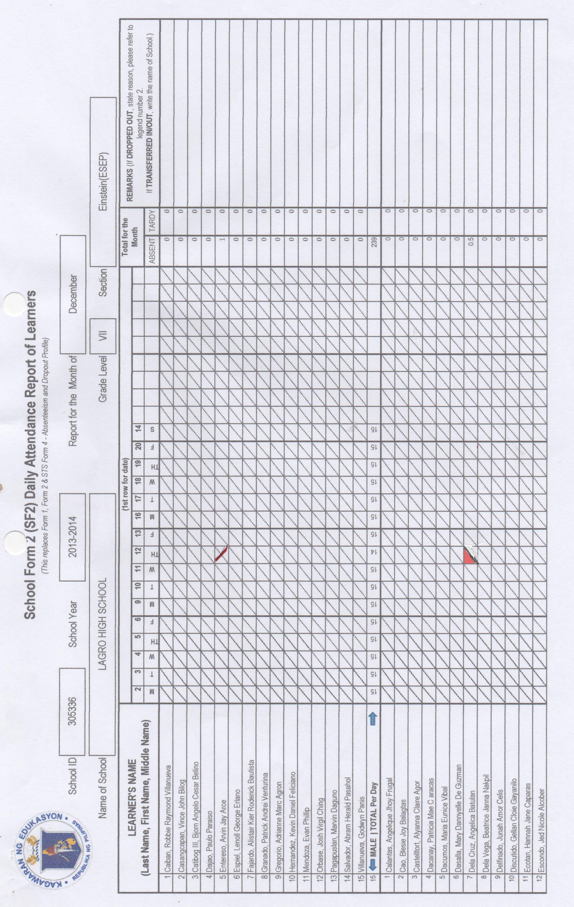

Slide 27
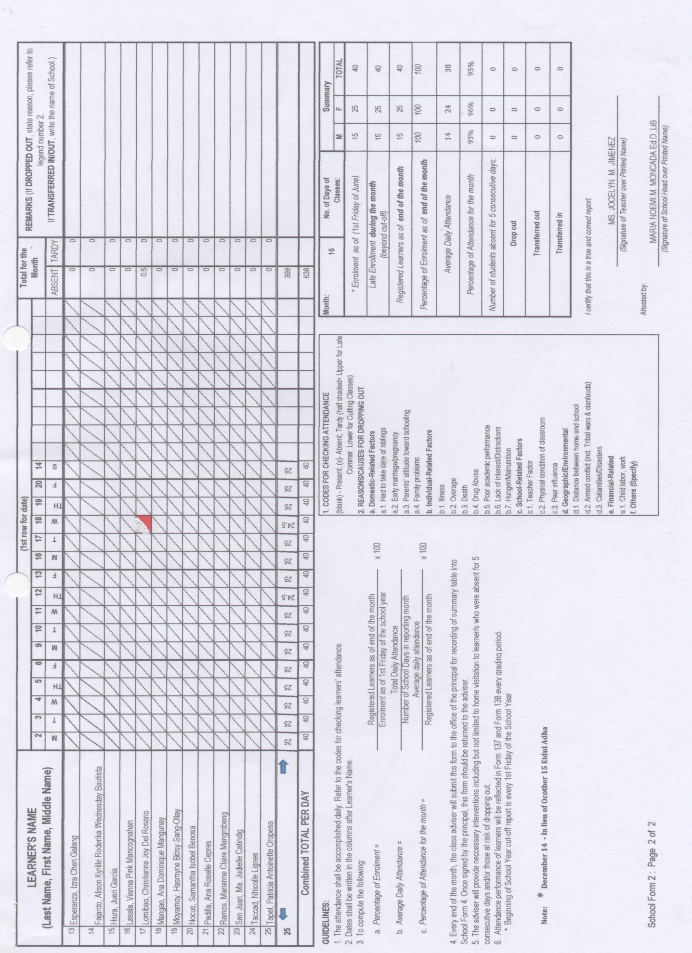

Slide 28
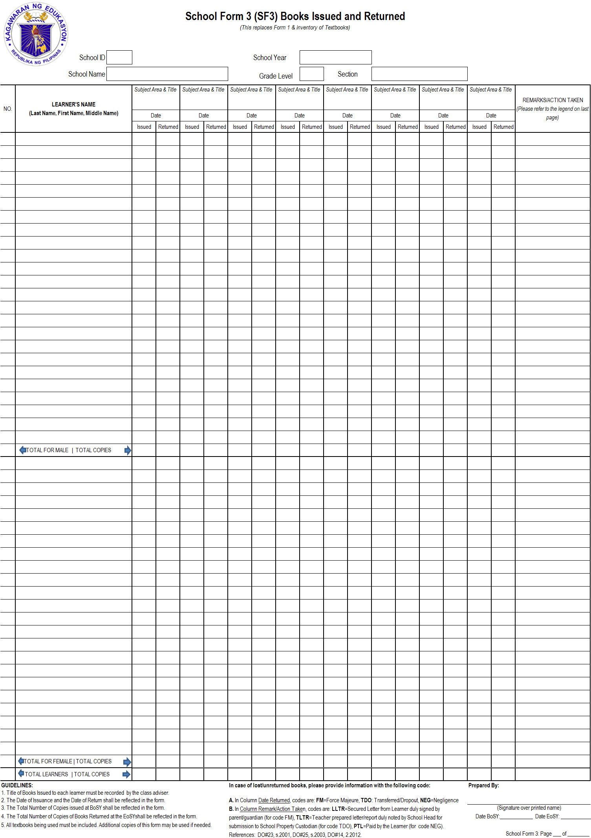
School Form 3 (SF3) Books Issued and Returned (This replaces Form 1 & Inventory of Textbooks)

Slide 29
SCHOOL FORMS Data Element Descriptions SF 3- Books Issued and Returned
 | DATA ELEMENT | DESCRIPTION
1 | School ID | A six (6) digit-number assigned to a school recognized in EBEIS
2 | School Year | The prescribed period of time when schools offer daily instruction. It covers10 months of regular schooling starting month of June (Beginning of School Year) up to the month of March (End of School Year) of the following year.
3 | School Name | Official name of school as registered in DepED and EBEIS
4 | Grade Level | A degree/stage of a learner classified according to age and progress.

Slide 30
SCHOOL FORMS Data Element Descriptions SF 3- Books Issued and Returned
 | DATA ELEMENT | DESCRIPTION
5 | Section | A group of pupils/students convened together to receive instruction in a given course or subject.
6 | Month | Month covered in the report
7 | Name of Learner | Name of learner as reflected in the birth certificate or equivalent document
8 | Title of the Book & reference for what subject area | The name of the book given to each learner. The subject area to which the book is issued should also be reflected

Slide 31
SCHOOL FORMS Data Element Descriptions SF 3- Books Issued and Returned
 | DATA ELEMENT | DESCRIPTION
9 | Date Issued | The day the learner received the book allotted to him/her.
10 | Date Returned | The day the learner returned the book allotted to him/her. (In case of losses/unreturned, applicable code will be written in this column. The codes are: FM=Force Majeure, TDO: Transferred/Dropout, NEG=Negligence)
11 | Remark/Action Taken | May provide additional information for lost/unreturned or damaged books. Actions taken by the teachers are coded with the following description: LLTR=Secured Letter from Learner duly signed by parent/guardian (for code FM), TLTR=Teacher prepared letter/report duly noted by School Head for submission to School Property Custodian (for code TDO), PTL=Paid by the Learner (for code NEG)

Slide 32
SCHOOL FORMS Data Element Descriptions SF 3- Books Issued and Returned
 | DATA ELEMENT | DESCRIPTION
12 | Total Male | Total number of registered male learners
13 | Total Female | Total number of registered female learners
14 | Total Learners | Total registered learners
15 | Total Copies Issued | The total number of copies of each textbook issued by the teacher to the learners.
16 | Total Copies Returned | The total number of returned textbooks by the learners to the teacher.
17 | Signature of Teacher | The signature above printed name of the teacher who prepared the form.

Slide 33
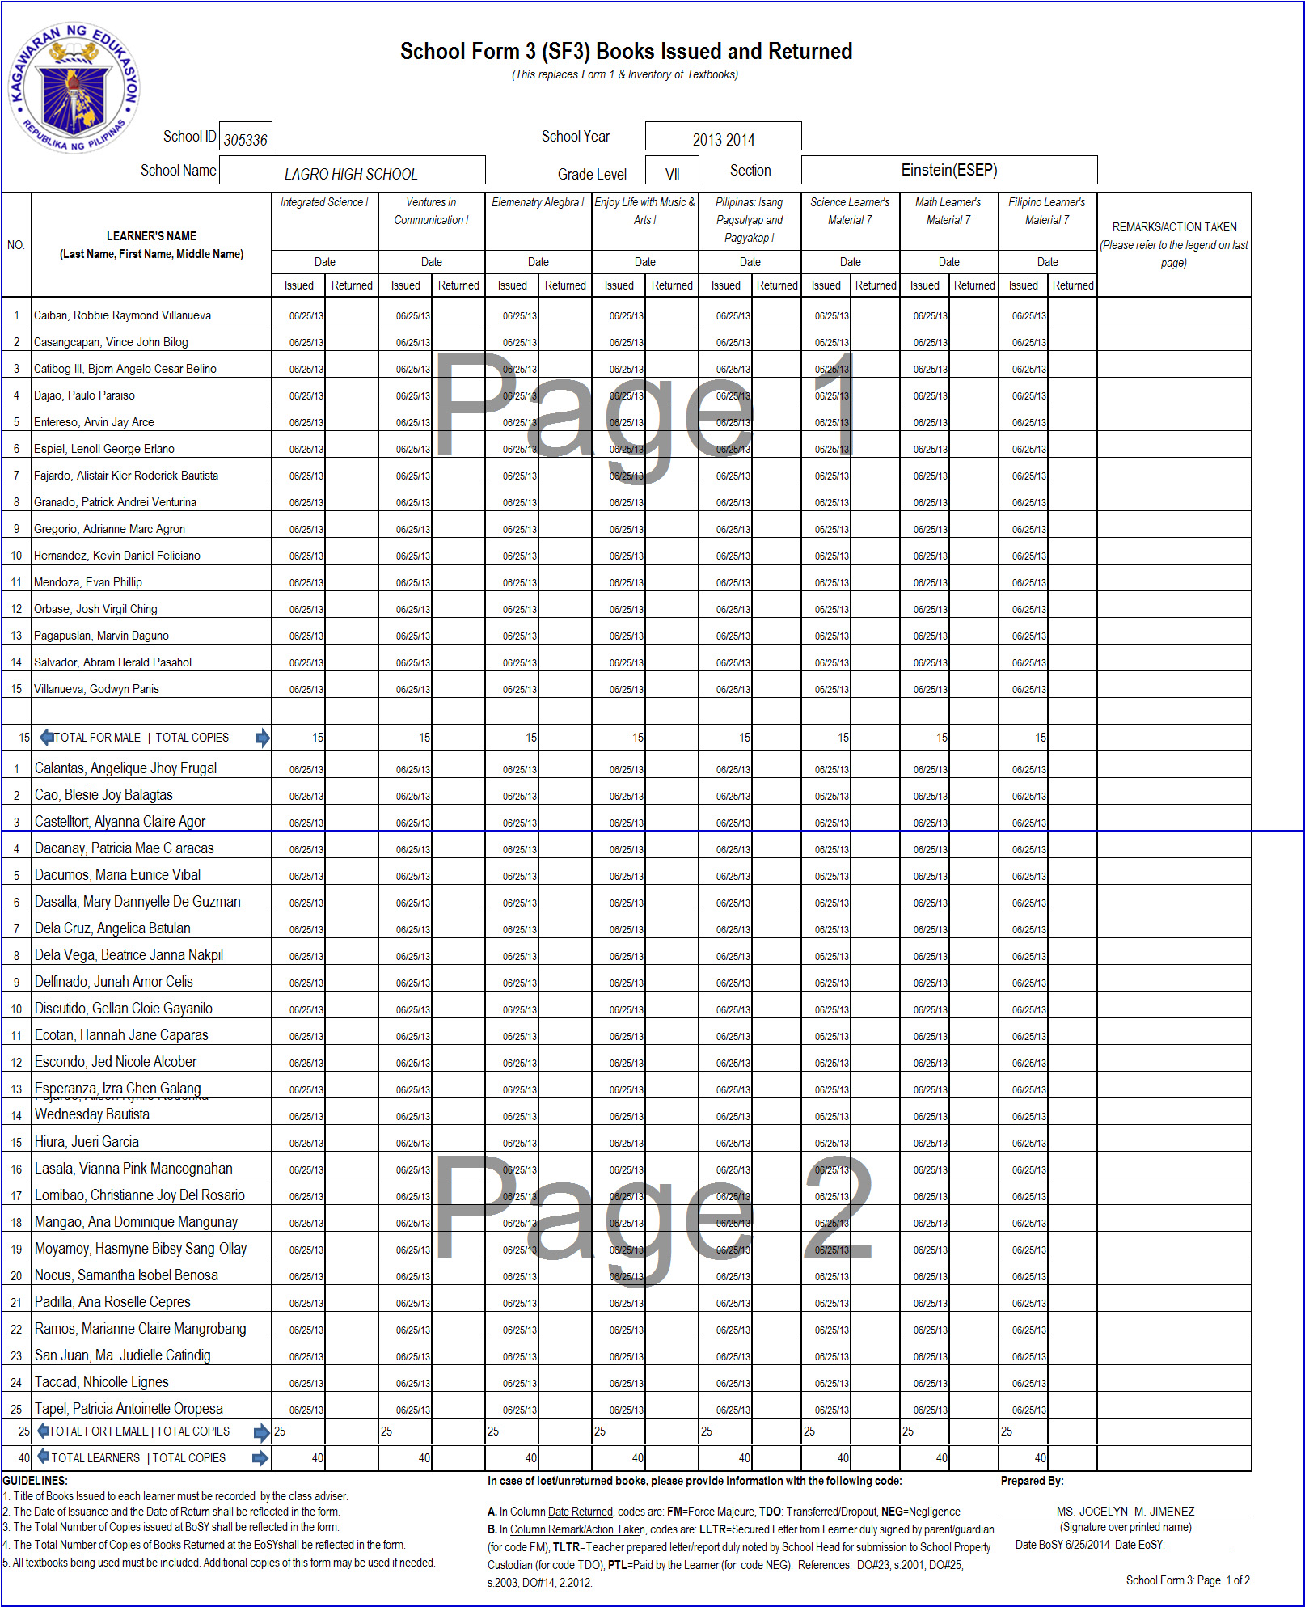

Slide 34
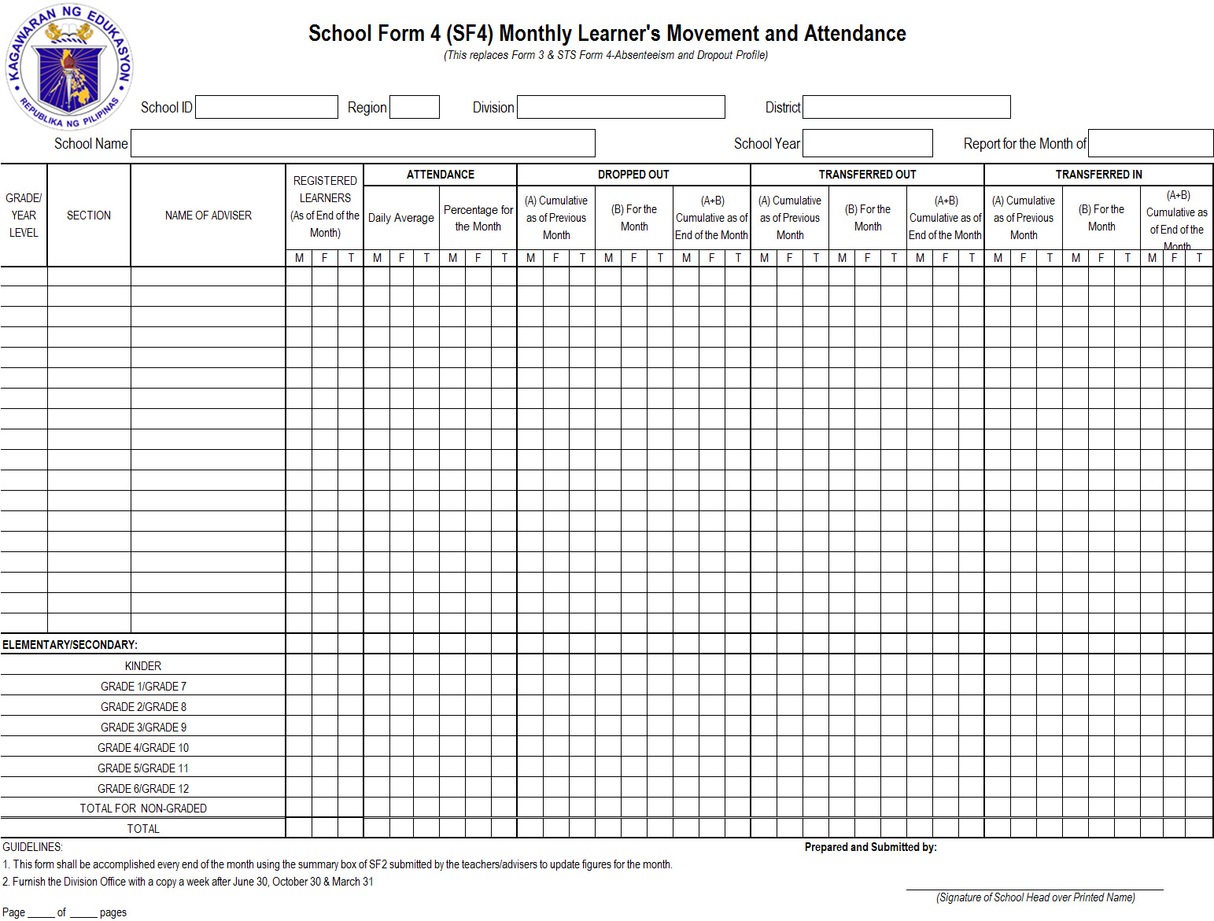
School Form 4 (SF4) Monthly Learner’s Movement and Attendance (This replaces Form 3 & STS Form 4- Absenteeism and Dropout Profile)

Slide 35
SCHOOL FORMS Data Element Descriptions SF 4- Monthly Learner’s Movement and Attendance
 | DATA ELEMENT | DESCRIPTION
1 | School ID | A six (6) digit-number assigned to a school recognized in EBEIS
2 | School Year | The prescribed period of time when schools offer daily instruction. It covers10 months of regular schooling starting month of June (Beginning of School Year) up to the month of March (End of School Year) of the following year.
3 | School Name | Official name of school as registered in DepED and EBEIS
4 | Section | A group of pupils/students convened together to receive instruction in a given course or subject.

Slide 36
SCHOOL FORMS Data Element Descriptions SF 4- Monthly Learner’s Movement and Attendance
 | DATA ELEMENT | DESCRIPTION
5 | Month | Month covered in the report
6 | Name of Adviser | The person in the school assigned to supervise, guide & direct a specific class and actual teaching to his/her assigned class and other classes, if there is any.
7 | Grade/Year Level | A degree/stage of a learner classified according to the age and progress.
8 | Section | A class or group of students taking the same grade and performance level

Slide 37
SCHOOL FORMS Data Element Descriptions SF 4- Monthly Learner’s Movement and Attendance
 | DATA ELEMENT | DESCRIPTION
9 | Registered Learners (As of End of the Month) (Male/Female/ Total) | The number of learners (M/F/Grand Total) who are enrolled and registered in the school in the current month.
10 | Attendance: Daily Average | This is the average daily attendance of learners by section/grade/ and total for school divided by the total number of school days for the month. Total Daily Attendance Average Daily Attendance = ------------------------------------ Number of School Days in reporting month

Slide 38
SCHOOL FORMS Data Element Descriptions SF 4- Monthly Learner’s Movement and Attendance
 | DATA ELEMENT | DESCRIPTION
11 | Attendance: Percentage for the Month | The percentage of the attendance for the current month with a computation of: Average Daily Attendance Percentage of Attendance = ---------------------------------- x100 for the month Registered Learners as of end of the month
12 | Drop Out Cumulative as of Previous Month (Male/Female/Grand Total) | Total number of learners (male/female/grand total) who left school in the previous months.

