Slide 1
EXTERNAL ASSESSMENT
Enhancement Program for Division Trainers on Strategic and Operational Planning Process and Content
July 5, 2013 – DepEd NCR Conference Hall

Slide 2
External Environment Assessment
Macro
Environment
Market
Analysis
Industry, Sector and Area Analysis
Micro Market
Analysis
Opportunities
Threats

Slide 3
Focal Points of the External Assessment
K to 12
Student-Centered Learning (SCL)
School Based Management (SBM)
Important and relevant education statistics
21st Century Education

Slide 4
4 levels of external assessment
Level 1. The Macro Environment
Level 2. The Industry/Area/Sector
Level 3. The Market
Level 4. The Micro Market

Slide 5
Steps in Conducting a Macro Environment Assessment
LEVEL 1. THE MACRO ENVIRONMENT
Step1
Determine what are the relevant information that will help you achieve your unit’s Vision, Mission and Objectives.
Step 2
Gather the relevant information through the various research methods available to you.
Step 3
Analyze the information using four criteria: Relevance, Magnitude, Importance, and Urgency

Slide 6
RELEVANCE
Select the information or analysis that allows you to achieve your VMOKRAPI.
MAGNITUDE
Magnitude can be best analyzed by using various mathematical models, which are represented by charts, diagrams and tables.
IMPORTANCE
Dwells on the “cause and effect” analysis
The unit must identify which information create the most impact on the actual or potential outputs and outcomes of your unit. By doing so, the unit must be able to trace the root “causes” which most influence the desired education “effects.”

Slide 7
URGENCY
Certain things have to be attended to immediately before others. These are of an urgent nature and must take precedence because it may be useless to proceed if they are not attended to first.
Urgency also implies immediacy of action because of impending problems or, even, crisis situations.

Slide 8
Steps in Conducting a Macro Environment Assessment
Step 4
Synthesize the data.
Synthesis is the final process of weaving all the information together to develop meaningful findings or conclusions, that is, one that would help your unit achieve its goals.

Slide 9
Steps in Conducting a Macro Environment Assessment
Step 5
Use the data to strategize.
The synthesized data allows you to evaluate your unit’s current position in the education terrain.
Where are the Opportunities open to your unit for achieving your VMOKRAPI?
What are the Threats that may hinder your unit from achieving its VMOKRAPI?
What factors are more compelling than others which you should attend to?

Slide 10
Steps in Conducting a Macro Environment Assessment
Step 6
Forecast and create scenarios
You may use different techniques in forecasting possible scenarios in the future through mathematical, logical, and intuitive means.
The freehand method is used when the forecaster thinks that the critical factors affecting past trends would no longer apply to the future.

Slide 11
FACTORS FOR EXTERNAL ASSESSMENT
SOCIAL FACTORS
POLITICAL FACTORS
ECONOMIC FACTORS
ECOLOGI-CAL FACTORS
TECHNO-LOGICAL FACTORS

Slide 12
Social Factors
Demographic profile of the relevant population
Can be found through government & non-government owned institutions such as NSO, World Bank, ADB, and other statistical databases on the internet
Political Factors
Deal with power structures and forces which influence the environment’s governance system and its external linkages
Cover the laws, rules, regulations, procedures and processes both the national and local governments, which would dictate the desired ideal behavior from the population

Slide 13
Economic Factors
Involve all productive forces generated by capital, land, and labor both for the formal and informal sectors
The commonly monitored economic indices are GNP, GDP, Employment & Unemployment Statistics, increasing prices of goods and services, poverty levels in the area, among others
Ecological Factors
Refer to the status of your area’s natural resources, ecosystems, and habitats
Include weather and climate and the quality of air, water, soil, and waste disposal systems

Slide 14
Technological Factors
Point to the various methods and means of delivering programs and classes
From the typical face to face or classroom interaction, learning has been taken to the digital world through Internet, cyber classes, and digital discussion boards
Faculty may record their lectures from their offices/homes through simple softwares that can be run on their laptops, i.e. “screencasts”
Smart classrooms in schools

Slide 15
INDUSTRY ANALYSIS
LEVEL 2. INDUSTRY, AREA, AND SECTOR ASSESSMENT
defines your industry
your unit = education services industry
Different Education Levels to Categorize your Industry
Basic Education
Technical-Vocational Education
Higher Education
Professional Education

Slide 16
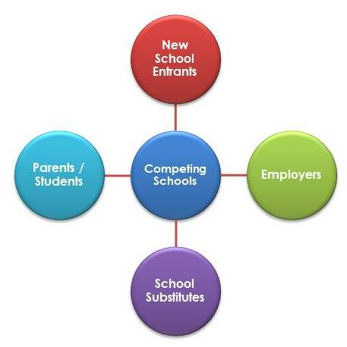
education industry may be further analyzed in the context of its relative attractiveness to investors in the education industry (Michael Porter’s Five Forces of Industry Analysis)
Education Industry Analysis
The model evaluates the relative bargaining power of the schools against their suppliers and against their customers (parents and students). It also depicts the relative ease or difficulty of entering the industry and the schools substitutes available to customers.

Slide 17
INDUSTRY STRUCTURE
there are many participants and stakeholders in the education industry
SCHOOLS = direct industry participants
Related Industry
textbook publishing
Stakeholders
public and private sector agencies involved in promoting and supporting education
Government’s Role
to develop the national agenda for education through its various agencies: DepEd, CHED, and TESDA

Slide 18
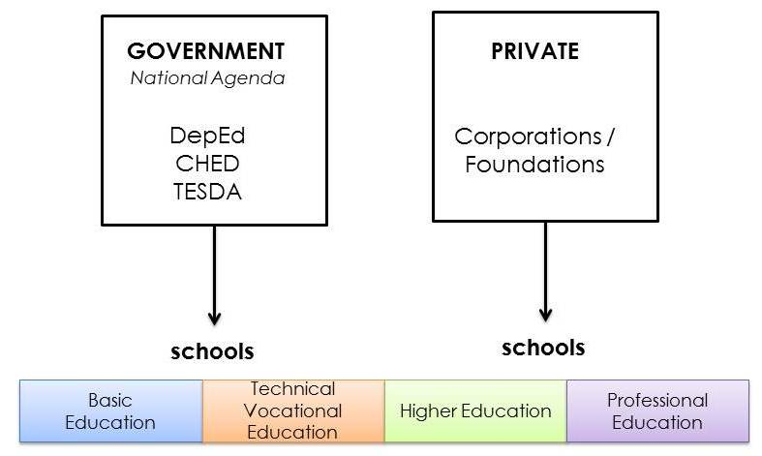
Sample
Figure A. Education Industry Structure
This structure is further complemented by a set of “suppliers” and “demanders.”

Slide 19
EDUCATION VALUE CHAIN
the education industry has its own value chain
Figure B. Education Value Chain

Slide 20
SECTOR ANALYSIS
E N T E R P R I
S
E
S
I
N
S
T
I
T
U
T
I
O
N
S
P
A
R
E
N
T
S
STUDENT SECTOR
Education Industry
Schools and their Suppliers
EMPLOYMENT SECTOR
The market for education services
The market for education graduates

Slide 21
AREA ANALYSIS
Political stakeholders
Economic stakeholders
Social stakeholders
Technological stakeholders
Ecological stakeholders

Slide 22
INDUSTRY ANALYSIS
LEVEL 3. MARKET ASSESSMENT
market is composed of customers who pay for the goods or services sold by the suppliers of these items
The question is...
Who pays for Philippine Basic Education?

Slide 23
Figure E illustrates how the education industry bridges the Demand for and the Supply of education services...
FIGURE E. Four Markets of Education Services
Taxpayers
National and Local Governments
Resources for Capital Outlay, Personnel Services and Operating Expenses
School System and the Provision of Education Services
Graduates of Schools
Household Income
Parents
Defray Expenses of Students
Donor Community
Donations
Capital Outlays, Personnel Services
Operating Expenses
Business Enterprises and Institutions
Salaries, Wages, Benefits
Employee Services

Slide 24
Figure F depicts the Supply and Demand for Education by the four customer groups: the government, the parents, the donors and the employers
FIGURE F. Market Supply and Demand
Customer Groups | What is supplied by DepEd | What is Demanded by Customers
National and Local Governments | Education Services for All Filipinos of School Age | Productive and Enlightened Citizens
Parents | Education Sessions to Those Who Avail of Basic Public Education | Skilled and competent graduates who can get decent work with decent pay
Donors | Good School Education Systems | Public Recognition and Naming Rights Tax Deductions
Employers | Good Graduates of Education Institutions | Skilled and Competent Graduates Ready for Employment and Imbued with Correct Values Employable Graduates with all the Necessary Skills, Competencies and Values

Slide 25
The next task in Market Assessment is to quantify the Demand and Supply along the Education Value Chain. See Figure G.

Slide 26
LEVEL 4. MICRO MARKET ANALYSIS
Focusing in the immediate market of your unit, it would be advisable to have a deeper understanding of your various customer groups (as explained in Level 3: Market Assessment).
Since this is your immediate market, you can obtain data from your own students and their parents.

Slide 27
On the job market, make a tracer study of the graduates of your unit.
How many are employed, where are they employed?
What are their positions in the organizations they work for?
What kind of jobs do they have, what salary levels do they realize?

Slide 28
You can also determine whether their skills set and competencies match the jobs they have.
You will discover that some of your graduates are not employed or are underemployed. Find out why. You can also survey the employers of your graduates and ask whether they are satisfied with their recruits’ skills set and competencies. What competency and character gaps do they see?

Slide 30
EXTERNAL ANALYSIS

Slide 31
EXTERNAL ANALYSIS
Area
Data | Opportunities | Threats
NCR has a robust economy, being the top contributor to the national economy with 35.7% share of the country’s GDP Biggest regional budgetary allocation in the amount of P129.4B out of P990.4B national budget 63.7% or 5.10M out of 66.3% or 41.19M persons in the labor force NCR posted the largest group of employment in the entire country at 24.5% laborers and unskilled workers 16.4% government officials and employees 15.5% service workers NCR is also a reservoir of major government agencies (Source: NSCB/NSO) | Potential for in-migration - the more people migrate to NCR, the more potential enrolees there are for schools Biggest potential for both public and private partnership as recipients of private entities’ corporate social responsibilities | Presence of informal settlers (584,525 families – Source: NHA-NCR) that cause classroom congestion Limitations in terms of schools current resources to accommodate the influx of potential enrolees Limited buildable space for the construction of school buildings due to nearby business establishments High magnitude of poor families (53%-Poverty Rate)
Economic

Slide 32
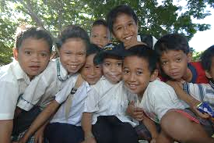
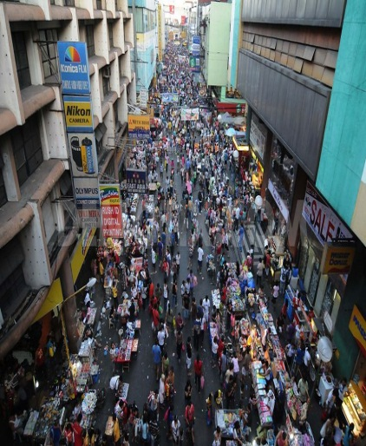
EXTERNAL ANALYSIS
Area | Data | Opportunities | Threats
Social | 8.01M out of 62.16M total population 15 years over 2.11% annual population growth rate (NSO) 99% simple literacy rate and 94.6 functional literacy rate (FLEMMS) Approximately 3.5M are informal dwellers, with 295,164 estimated number of school age-children (MMDA) Center of colleges and universities (201)- Source: MMDA, Hospitals (198)-Source: Philippine Nursing Directory, and Commercial Establishments (211,974) in the country Melting pot of the country Source: DTI Website | The youth represent the beneficiaries as market of the education sector. Potential partners/ service providers for K to 12 curriculum reform and other major education activities Increased employment opportunities even at a young age | Poverty rate (53%) may prevent basic education learners from surviving in schools. High chances of PARDOS/ SARDOS in schools

Slide 33
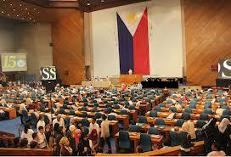
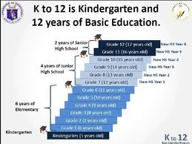
EXTERNAL ANALYSIS
Area | Data | Opportunities | Threats
Political | 30 congressional districts 16 cities and 1 municipality with a number of Civil Society Groups, Unions, Media Groups/ Practitioners (Source: DILG) 7.2B SEF which was increased by 20% from the previous year The Philippine government has embarked on instituting the K to 12 reform. | Potential for education support/ Political navigation/ Social marketing Robust support of LGU/NGA to various educational programs and services especially in Adopt-A-School Program and Brigada Eskwela For basic education, they have increased the budget allocation to cover Grades 11 and 12 | Movement of DepEd personnel from one station to another Control of SEF funds in support to basic education services Priority needs are not addressed The SUCs will not have any revenue for the first year college level starting SY 2016-17. In the succeeding SY, their revenue loss will be equivalent to two college levels, first year and second year.

Slide 34
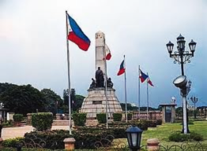
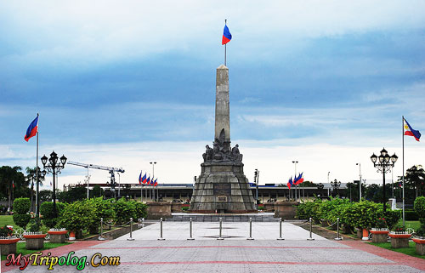
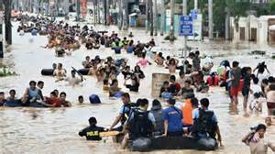
EXTERNAL ANALYSIS
Area | Data | Opportunities | Threats
Ecological | 127 parks in Metro Manila (Source: Philippine Institute for Development Studies) Generated 5,250 m. tons per day or 162,750 m. tons per month or 1.95M m. tons per year of waste/garbage Frequent floods in Metro Manila and its environs, average of 10 floods per year – Source: MMDA | Potential for learners for biological research works Potential for waste segregation, income generation, and schools’ eco-savers program | Caused major floods and other environmental hazards in the metropolis Frequent disruptions of classes (an average of 8% or 15 days out of 200 days school calendar)

Slide 35
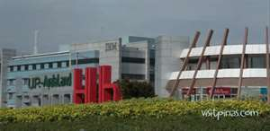
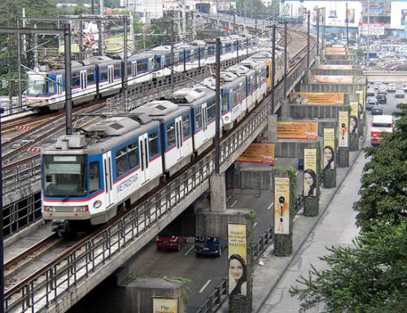
EXTERNAL ANALYSIS
Area | Data | Opportunities | Threats
 | NCR - the Center of Technological Advancement in the Philippines and expected to remain as main venue for ICT. NCR ICT sector continues to be an economic driver with the GDP share increased from 2.7% to 4.8%/Internet connections availability and accessibility to telephone connections, computers and internet. (Source: CICT) Metro Manila accounts for 75% of BPOs or approximately 141 thousands in the country - Source: Business Processing Association of the Philippines (BPAP)/DTI | Opportunity for education to deliver Open Learning System and optimize the use of ICT in addressing access, quality, efficiency and governance Easy access of information (everything at your fingertips) | Proliferation of internet cafes adjacent to schools in the metropolis caused learners to cut class and lack focus in studies (Source: Action Research Findings)
Technological

