Slide 1
INTERNAL ASSESSMENT
Enhancement Program for Division Trainers on Strategic and Operational Planning Process and Content
July 5, 2013 – DepEd NCR Conference Hall

Slide 2
10 Levels of Internal Assessment
First Level of Assessment: Evaluating Performance Outputs and Outcomes
Sixth Level of Assessment: Evaluating Teams and Individuals
Second Level of Assessment: Evaluating Organizational Competencies and Capabilities
Seventh Level of Assessment: Evaluating Physical Facilities and Set Up, Working Conditions and Environmental Surroundings
Third Level of Assessment: Evaluating Utilization of Resources
Eighth Level of Assessment: Evaluating Organizational Affiliations, Alliances and Linkages
Fourth Level of Assessment: Evaluating Management Processes
Ninth Level of Assessment: Evaluating Top Management, Board Members and Leadership
Fifth Level of Assessment: Evaluating the Four Management Functions
Tenth Level of Assessment: Evaluating Strategic Fit or VSOP Consistency

Slide 3
FIRST LEVEL OF ASSESSMENT
EVALUATING PERFORMANCE OUTPUTS AND OUTCOMES
OUTPUTS
- products or services that the education unit produces and delivers
OUTCOMES
- desired end results identified by the organizational unit to serve as a guide for evaluating the overall performance of the unit
Ways to analyze performance
Time Series or Historical Analysis of Performance Indicators
Analysis of Actual Performance vis-à-vis Targets Set
Benchmarking

Slide 4
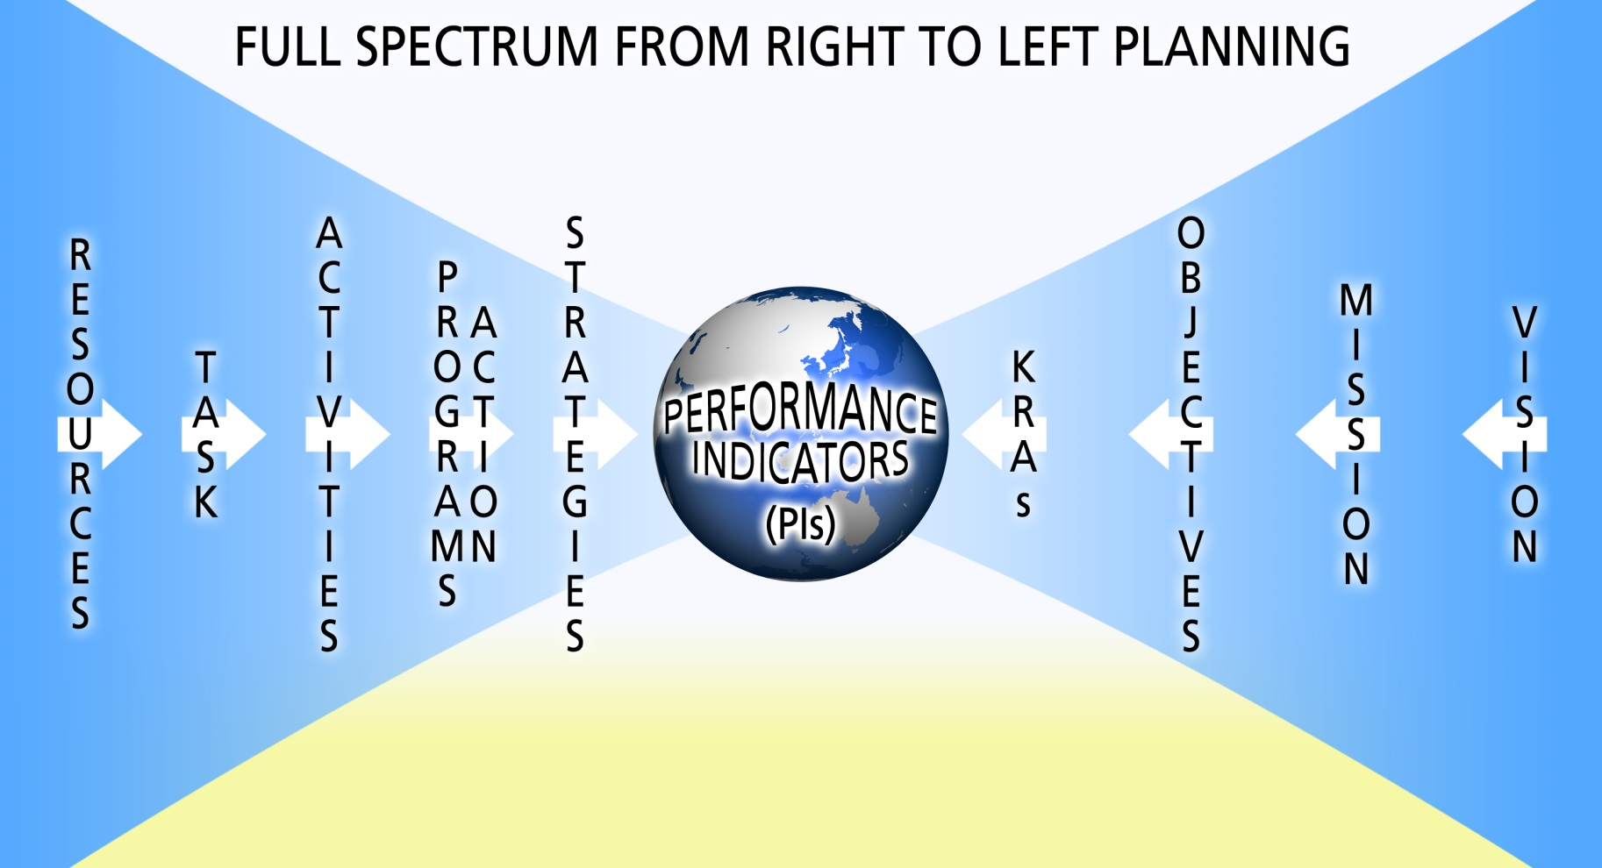
VMOKraPiSPATRes
Means
Outcomes
Input
(Budget)
Throughput
(PAPs)
Output
(MFOs)
Outcome
(MFOs)
Notes:
Input – PPP (People, Physical, Peso) Morato’s Framework
Input – Budget DBM
MFOs – Major Final Outputs
Note:
Per Dr Morato, the MFOs are actually outputs and outcomes (please refer to page 5 of 51)

Slide 5

Efficiency Measures
Input-Output Ratio:
comparing inputs poured (teachers, classrooms) in versus outputs (students educated) produced
Cycle Time (Throughput Time)
computing how long it takes the organization to transform the unit’s inputs into a specified quantity of outputs
Rate of Dropout/Rate of Retention of Students

Slide 6
Efficiency Ratios (Input-Output)
  Full Time Teacher: Pupil/Student Ratio
  Classroom: Pupil/Student Ratio
  Textbook: Pupil/Student Ratio
  Space per pupil/student
  Others

Slide 7
Economy Ratio
Economic Measures
Cost Benefit Ratio:
comparing the costs of producing a product or rendering a service to the benefits it generates
Investment Return Ratio:
comparing programs or projects investments to economic returns
  Cost per Pupil/Student per Year
  Cost per Organizational Unit
  Cost to Educate Students for Entire K to 12 Duration
  Cost per Square Meter of Facilities Built

Slide 8




Effectiveness Measures
VS.
Resources Spent
Outcomes achieved

Slide 9
Effectiveness Measures
Resources Utilized (people, pesos, physical facilities) versus Student Outcomes Attained
Percentage of Students Employed Six Months after Graduating
Others

Slide 10
SECOND LEVEL OF ASSESSMENT
EVALUATING ORGANIZATIONAL COMPETENCIES AND CAPABILITIES
looks at the capabilities and competencies of the organization
Capabilities and Competencies

Slide 11
It is the basis for evaluating organizational competences and skills because the SPAT represents what the organization must do and implement well in order to achieve its outputs and outcomes
!
Other ways of evaluating organizational competencies and capabilities directly is…
to monitor and evaluate the performance outputs and outcomes very well in Level 1.
to go down to the individual or team level

Slide 12
THIRD LEVEL OF ASSESSMENT
EVALUATING THE UTILIZATION OF RESOURCES
examines where the resources of the organization have been sourced and where they have been allocated
Efficiently utilized
Economically utilized
Resources
Effectively utilized

Slide 13
FOURTH LEVEL OF ASSESSMENT
EVALUATING MANAGEMENT PROCESSES
examines and evaluates the organization's management processes.
These processes are the formal and informal systems and procedures of the unit
In assessing management processes, the top-most concern is to gauge whether or not they were crafted, carried out, coordinated, monitored and conducted well in terms of their effectiveness

Slide 14
FIFTH LEVEL OF ASSESSMENT
EVALUATING THE FOUR MANAGEMENT FUNCTIONS: Marketing, Operations, Human Resource and Finance
most complicated of all because it strikes at the heart of the major functions of marketing, academic, operations, student services, human resource and financial management
also includes an evaluation of programs and projects to achieve the organization’s goals
The 7 Ps to evaluate the Marketing Function (1):
Positioning – major strategic move that establishes the organization’s unique value proposition in the education landscape
Product or Service – the ideal graduate that the region/division/school is developing for the employment market
Package – service packages are more difficult to define since these involve the right combination of service delivery processes and steps/ refers to the terms and conditions attached to education services
Place – refers not only to location where the schools are situated but also to the physical accessibility and availability of the education services
Price – includes fees, transportation expenses, living allowances
People – the organization who recruit students and entice parents to send their children to school
Promotions and Advertising – should be evaluated in terms of the effectiveness of promotional and advertising activities

Slide 15
Assessment of Academic and Student Services Operations (2)
Concerned with the Education Delivery System (EDS) of the region/division/school
The education leader should always start with the desired end results, which are the performance outputs and outcomes, in order to design and execute a good EDS.
INPUTS
include the teachers, the classrooms, laboratories, gyms, playgrounds, learning materials, learning methods, the curriculum, the lesson plans, and all other necessary items to deliver the education services
OUTCOMES
graduates who are able to find good jobs/ graduates who are able to enter good colleges/ graduates are good, and upright moral citizens
OUTPUTS
number of student graduates who have learned the intended skills and competencies
THROUGHPUTS
are the academic transformation processes used by the schools

Slide 16
The 8Rs Human Resource Management Function (3)
Recruitment – the proper selection and hiring of people for the organization
Retooling – the training, education and building up of the skills, competencies and attitudes of individuals and teams within the unit
Routing – looks at the career paths of the people in the unit as well as their potential for upward and lateral mobility and flexibility
Retaining – focuses on the ability of the unit to ensure that people remain very productive and quite happy to be with the school
Reviewing – looks at the performance management system of the unit. The system should essentially determine specific performance indicators for each group of people and evaluate the individual’s potential performance and participation levels
Rewarding – determines whether the unit’s compensation and incentives package are commensurate to employees’ potential, participation and performance levels
Recycling – the organization’s ability to transfer or rotate its people to other meaningful jobs within the unit or to recycle them back to the “outside world” or the mainstream labor market through retirement, retrenchment and outplacement programs
Resonating – a two-way process where the organization leaders and managers cascade the vision, mission, objectives and strategies of the unit to the people and where the people elevate their personal and team aspirations to the management

Slide 17
The FINANCE Function (4)
F -inancing or raising the monetary resources needed to fund the investments of the unit
I -nvesting or the placement of funds in specific forms of assets (e.g. inventory, accounts receivables, property, plant, and equipment) in order to generate revenues and surpluses
N -egotiating for the best deals and receiving the best terms in all financing and investing transactions
A -dministering the people, resources and operational or control systems and procedures of the unit assigned to the Finance and Controllership departments
N -umbers gathering, recording, arranging, reporting and representing, which are translated into accounting entries, financial reports and management control information systems
C -ash management, meaning the trafficking and treasury of funds or the raising, keeping and releasing of funds
E -valuating the past, present and future performance of the school using diagnostic and prognostic tools and techniques

Slide 18

SIXTH LEVEL OF ASSESSMENT
EVALUATING TEAMS AND INDIVIDUALS
Assessment of teams and individuals should not be conducted on an absolute basis
Different potentials must be determined
Evaluate teams and individuals based on their relative performance

Slide 19
SEVENTH LEVEL OF ASSESSMENT
EVALUATING PHYSICAL FACILITIES AND SET-UP, WORKING CONDITIONS AND ENVIRONMENT
The competitiveness of an organization can be determined by the state of its physical assets, working conditions and environmental surroundings particularly the facilities, grounds and equipment it owns for education purposes.

Slide 20

EIGHTH LEVEL OF ASSESSMENT
EVALUATING ORGANIZATIONAL AFFILIATIONS, ALLIANCES AND LINKAGES
The organization's strength lies not just within itself but the network of stakeholders it is linked, allied, and affiliated with.

Slide 21

NINTH LEVEL OF ASSESSMENT
EVALUATING TOP MANAGEMENT, BOARD MEMBERS AND LEADERS
This level is the most sensitive part of internal assessment. More often, the evaluator of the organizational leadership is the leader himself or herself or a subordinate just below the leader.

Slide 22

TENTH LEVEL OF ASSESSMENT
EVALUATING STRATEGIC FIT OR VSOP (Vision-Mission-Objectives, Strategies, Organization and People) CONSISTENCY

Slide 23
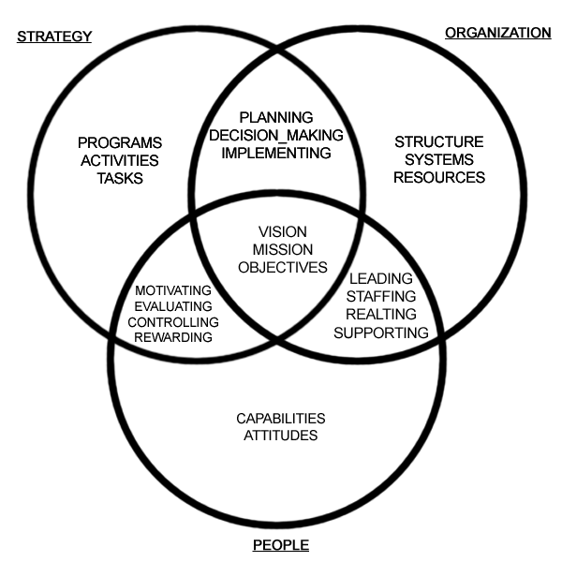
The inter-relationships of strategies, people and management process to achieve mission and objectives

Slide 25
INTERNAL ANALYSIS

Slide 26





INTERNAL ANALYSIS
Learning Environment (Basic Inputs) | Data | Strengths | Weaknesses
 | 57,185 Teachers (53,445-National Items + 3,740- LGU Funded) – 1:40 elem/1:34 sec | PTR/STR has improved for the last three years, within the national planning standard. | There is still a growing need/demand due to increasing trend (average of 3.24%) in enrolment every year.
 | 25,175 Classrooms (16,213-Elem + 8,962-Sec) – 1:77 elem/1:75 sec |  | Overcrowded classrooms (Pupil/ Student-Classroom Ratio- 1:77-elem/ 1:75-sec); 86% or 648 out of 759 schools with 2-shift and 1% or 6 schools with 3-shift classes Kindergarten classes with more than 3 shifts ( 194 schools out of 516 or 37.60%) Big class size (only 22% or 103 out of 462 schools elem & 16% or 40 out of 250 sec schools below 45 class size There are 271 schools or 35% of 764 schools have no buildable space in 15 schools division (except Pasig City) There is an existing 6,990 (3,948-elem/3,032-sec) classroom shortage.
 | 1,108,060 School Seats (685,878-Elem + 422,182-Sec) – 1:2 elem/sec | Pupil/Student-Seat ratio is within the standard at double-shift classes. | There is still a growing need/demand due to increasing trend (average of 3.24%) in enrolment every year.
 | Textbooks (Elem-1:1/ Sec-1:1) | Pupil/Student-Textbook ratio is within the planning standard in major subjects | There is still a growing need/demand due to increasing trend (average of 3.24%) in enrolment every year.
 | WatSan Facility (1 per school) | Water-Sanitation facility is sufficient per school | There is still a growing need/demand due to increasing trend (average of 3.24%) in enrolment every year.

Slide 27
INTERNAL ANALYSIS
Educational Outcomes (Performance Indicators) | Data | Strengths | Weaknesses
Access AIR/NIR/ GER/NER | AIR - 121.29% NIR – 62.04% GER Elem – 104.25% GER Sec – 98.43% NER Elem – 90.72% NER Sec – 78.00% | Increasing trend in access indicators (NIR-4% & NER-Sec-1%) for 3 school years | Decreasing trend in access indicators (GER-Elem & Sec-1%) for 3 school years - Divisions of Pasay City and Caloocan City- below 92%. 21.29% in AIR would account for over-aged/under-aged learners in Grade 1. It means that significant number of pupils are repeaters or entered schools at older/younger age – Only Division of Pasay City posted below 100%
Efficiency CSR/CR/ SLR | CSR G6 – 86.26% CSR Y4 – 84.47% CR Elem – 83.06% CR Sec – 79.08% SLR Elem – 2.93% SLR Sec – 5.77% | Increasing trend in efficiency indicator (Completion Rate – 2%) for the last 3 years both elem & sec | Increasing trend in efficiency indicator with an average (SLR-0.07%) for the last 3 years in elementary means that more leavers/dropouts are accounted for. Manila and Navotas City registered CSR rates of 78.79 and 71.07, respectively, the 2 lowest in the region.
Quality NAT | NAT G3 – 45.17% NAT G6 – 57.08% NAT Y4 – 49.32% | Improving international standing in Math & Science competitions individual and group categories (average of 10 competitions per year) | Decreasing trend in NAT in Grades 3&6 (G3-6%&G6-3%) for the last 3 years both public and private schools. Below PDP target which is 75% by G3-30%/G6-18%/Y4-26%) both public and private schools Out of 1,189,874 elementary pupils who took the Phil-IRI Test 37.87% or 370,060 pupils are under frustration level and 3.34% or 38,733 pupils are non-readers. In the secondary level (Mc Call Crabbs), 761 students are still reading at third grade level and below.

Slide 28



INTERNAL ANALYSIS
Curriculum and Instruction | Data | Strengths | Weaknesses
1. Curriculum | The schools are using 2002 BEC except for Grades 1 & 7 for K to 12. | Adopt ICT-based instruction in almost 100% schools both public and private There are potential donors/sponsors of instructional supplementary materials both formal and ALS. | Overcrowded/congested curriculum - teachers don’t entirely finish the competencies in 10 months plus the fact that less contact time for learners are allotted due to 2-shift classes
2. Instruction | 60% ICT enabled classrooms | Integration of ICT in teaching and learning in all subject areas | Result of reading test for Grades 1&2 teachers revealed that reading proficiency of teachers reached only 25% MPS in NCR thus contributing to low achievement level (Source: NETRC) 75% of teachers are using subject matter-centered learning approaches rather than child-centered

Slide 29

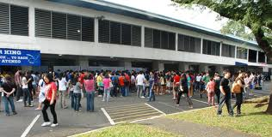

INTERNAL ANALYSIS
Private Schools | Data | Strengths | Weaknesses
 | 1,943 private schools (1,813-Kindergarten, 1,409- elementary, and 872- secondary | Private schools complement in providing access in all types of learners - Education Service Contracting (ESC)- 26,230 & Education Voucher System (EVS)- 15,934 grantees | Likewise, private schools registered below 75% NAT MPS

Slide 30


INTERNAL ANALYSIS
Governance and Other Organizational Capacities | Data | Strengths | Weaknesses
 |  | Institutionalized the following: Basic Education Information System (BEIS) Learner Information System (LIS) Human Resource Management Information System (HRIS) Financial management Information System (FMIS) Assets Management Information System (AMIS) Internal Audit System (IAS) Alternative Dispute Resolution (ADR) Collective Negotiation Agreement (CNA) Others | Need to establish the following: T & D System R & D System M & E System QA System TA System TQM/TQA R-NEAP LRMDS Still need to operationalize other systems and process for organizational efficiency and effectiveness 100% SBM Level 1 10% SBM Level 2 0% SBM Level 3

