Slide 1
SCHOOL FORMS Data Element Descriptions SF 4- Monthly Learner’s Movement and Attendance
 | DATA ELEMENT | DESCRIPTION
13 | Drop Out For the Month (Male/Female/Grand Total) | Total number of learners (male/female/grand total) who left school in a current month.
14 | Drop Out Cumulative as of End of Month Total (Male/Female/Grand Total) | The number of learners (male/female/grand total) who left schooling from the previous months and the current month.

Slide 2
SCHOOL FORMS Data Element Descriptions SF 4- Monthly Learner’s Movement and Attendance
 | DATA ELEMENT | DESCRIPTION
15 | Transferred Out Cumulative as of Previous Month (Male/Female/ Grand Total) | Total number of learners (male/female/grand total) who move out of original school where he is officially enrolled to enter another school from the previous months after enrollment.
16 | Transferred Out For the Month (Male/Female/Grand Total) | Total number of learners (male/female/grand total) who move out from the original school where he is officially listed to another school in a current month.

Slide 3
SCHOOL FORMS Data Element Descriptions SF 4- Monthly Learner’s Movement and Attendance
 | DATA ELEMENT | DESCRIPTION
17 | Transferred Out Cumulative as of End of the Month (Male/Female/Grand Total) | The number of learners (male/female/grand total) who move out from the original school where he officially listed to another school. Note: total from the previous months and for the current month.
18 | Transferred In Cumulative as of Previous Month (Male/Female/Grand Total) | The number of learners (male/female/grand total) who move in from one school where he officially enrolled to a new school from the previous months after enrollment.

Slide 4
SCHOOL FORMS Data Element Descriptions SF 4- Monthly Learner’s Movement and Attendance
 | DATA ELEMENT | DESCRIPTION
19 | Transferred In For the Month (Male/Female/Grand Total) | The number of learners (male/female/grand total) who move in from one school where he is officially enrolled and transferred IN to another school in a current month.
20 | Transferred In Cumulative as of End of the Month (Male/Female/Grand Total) | The number of learners (male/female/grand total) who moved in from one school where he officially enrolled but opt to transfer to another school from the previous months after enrollment including the current month.
21 | Name Signature of School Head | The name and signature of the school head who prepared the form.

Slide 5
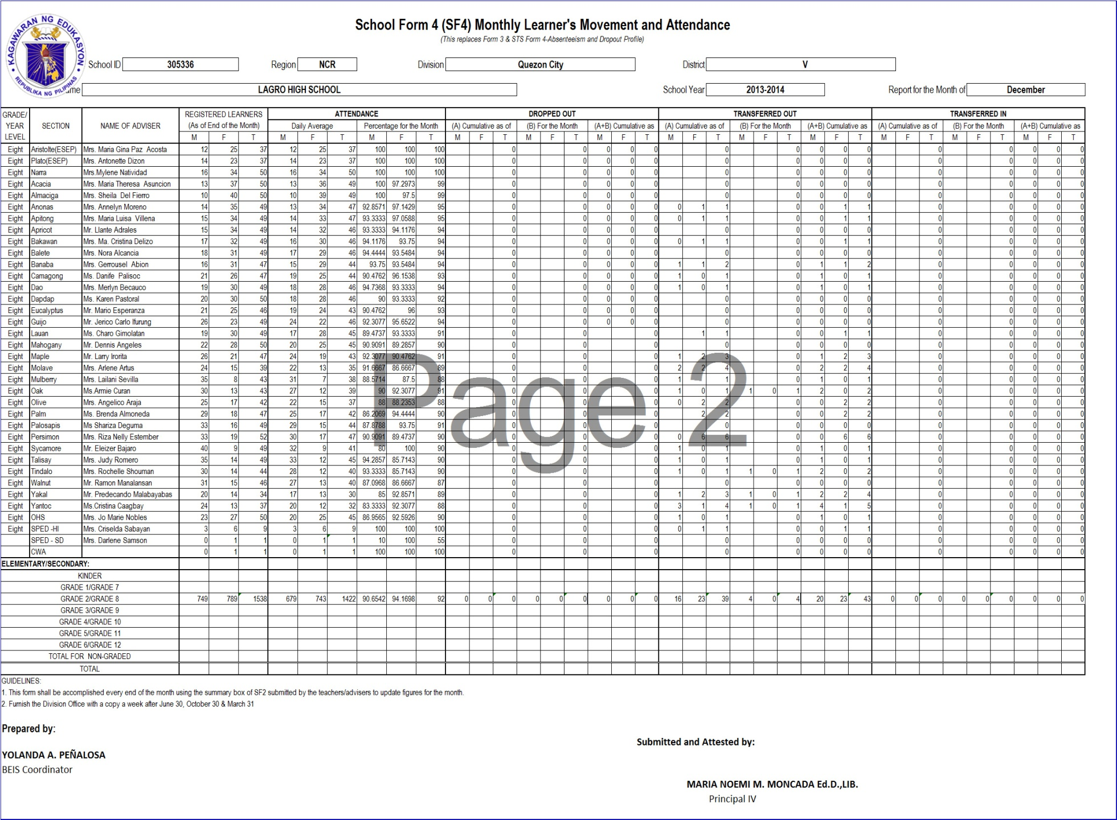

Slide 6
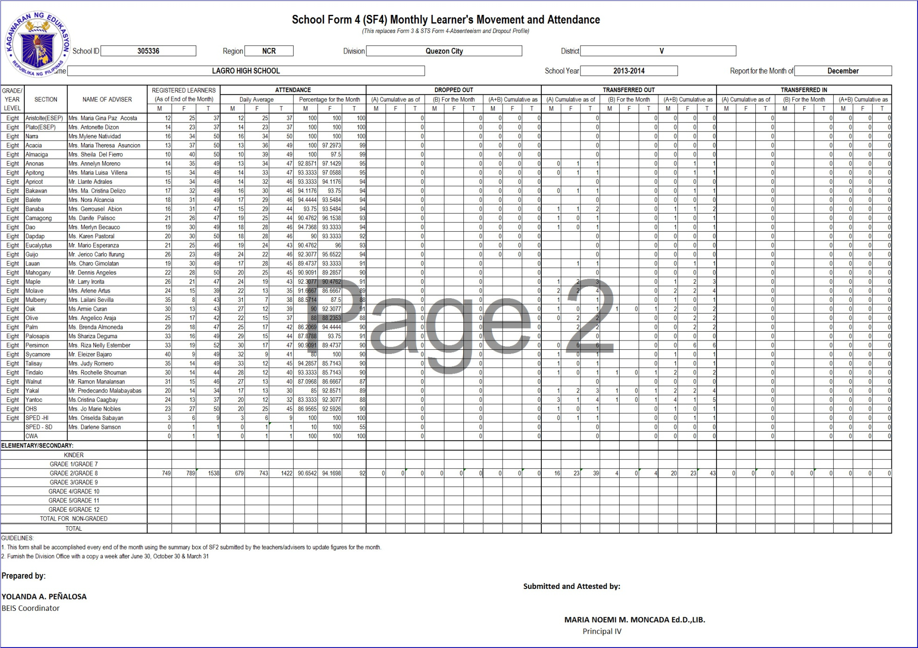

Slide 7
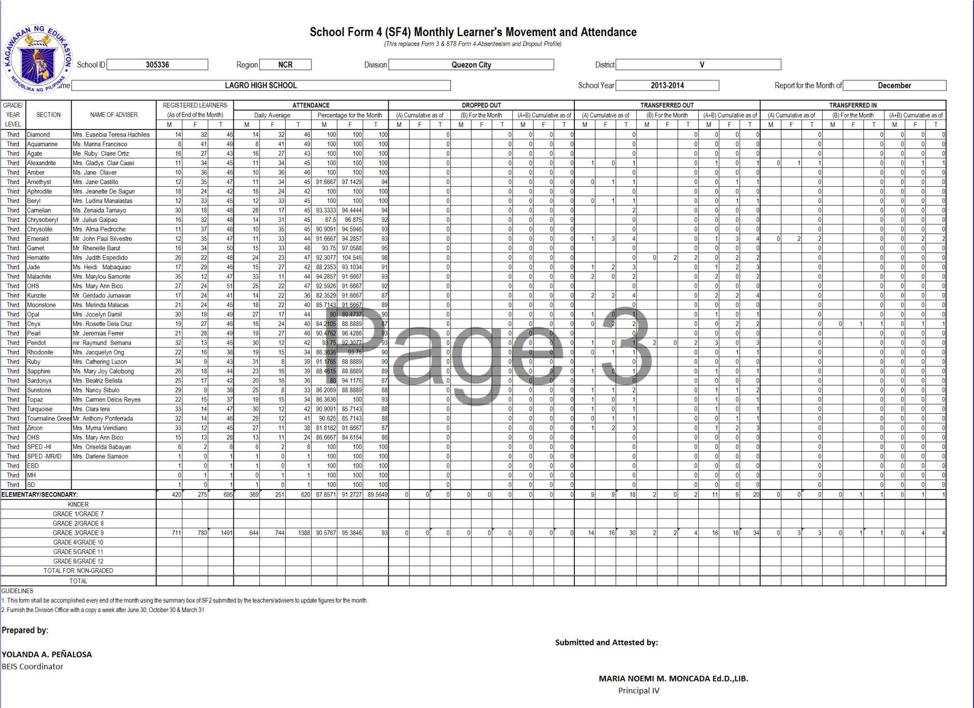

Slide 8
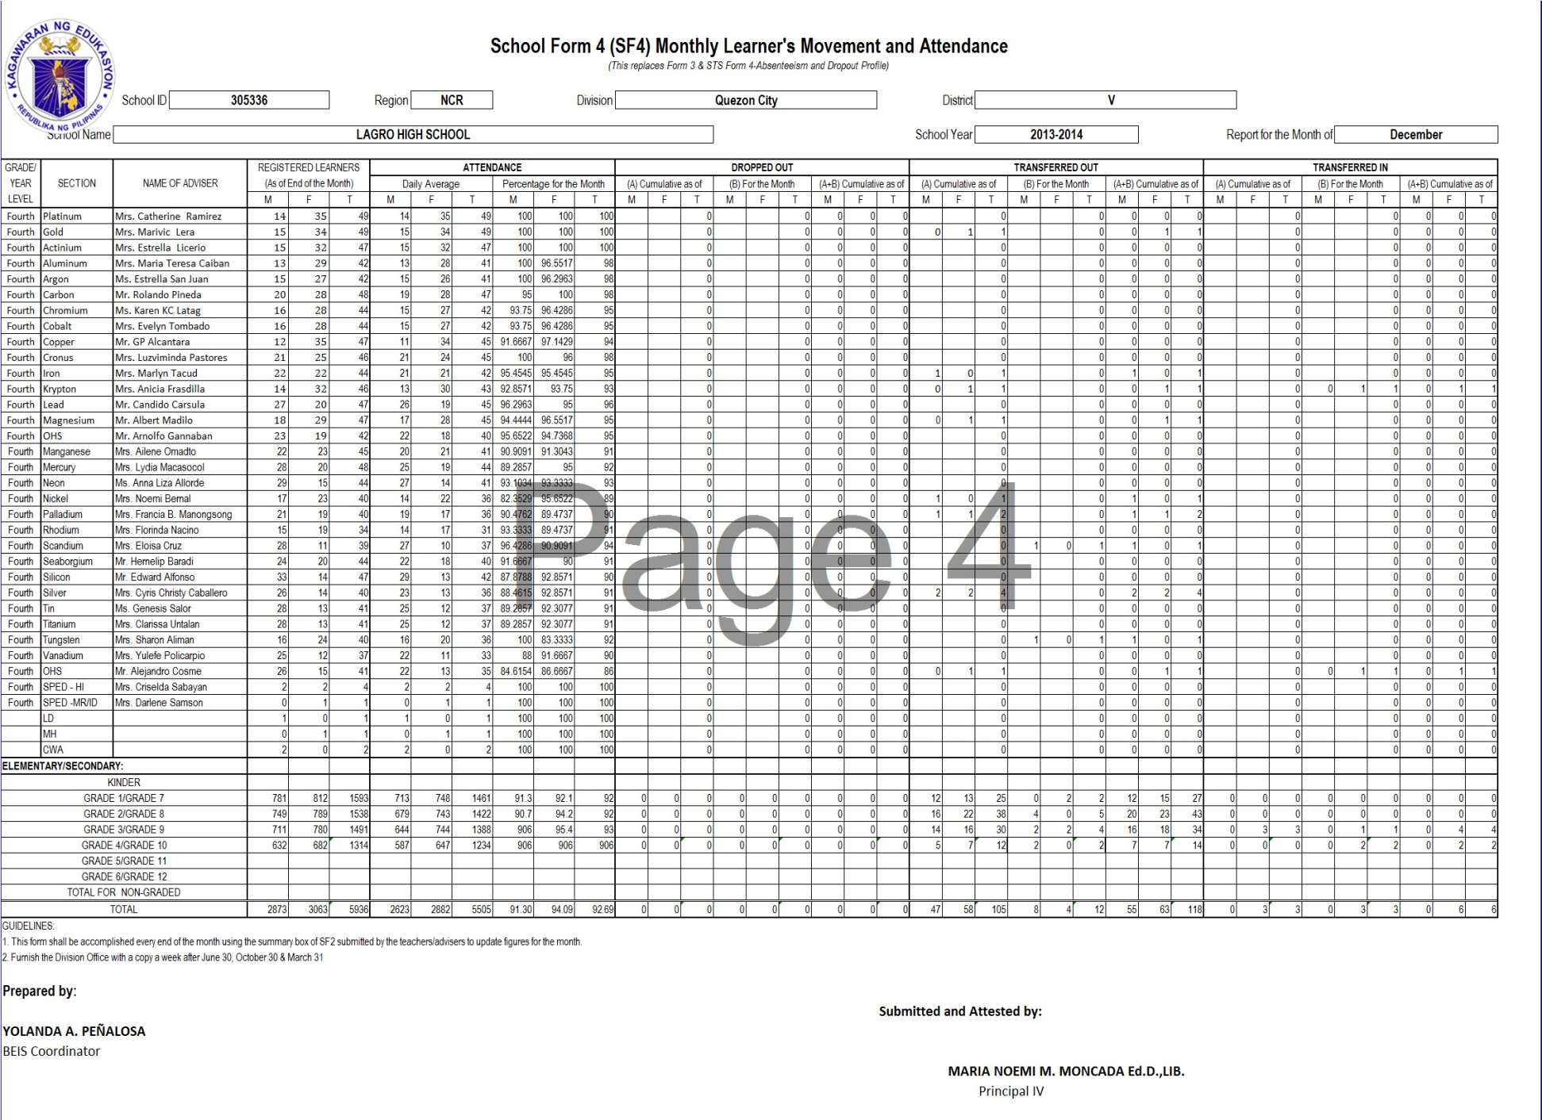

Slide 9
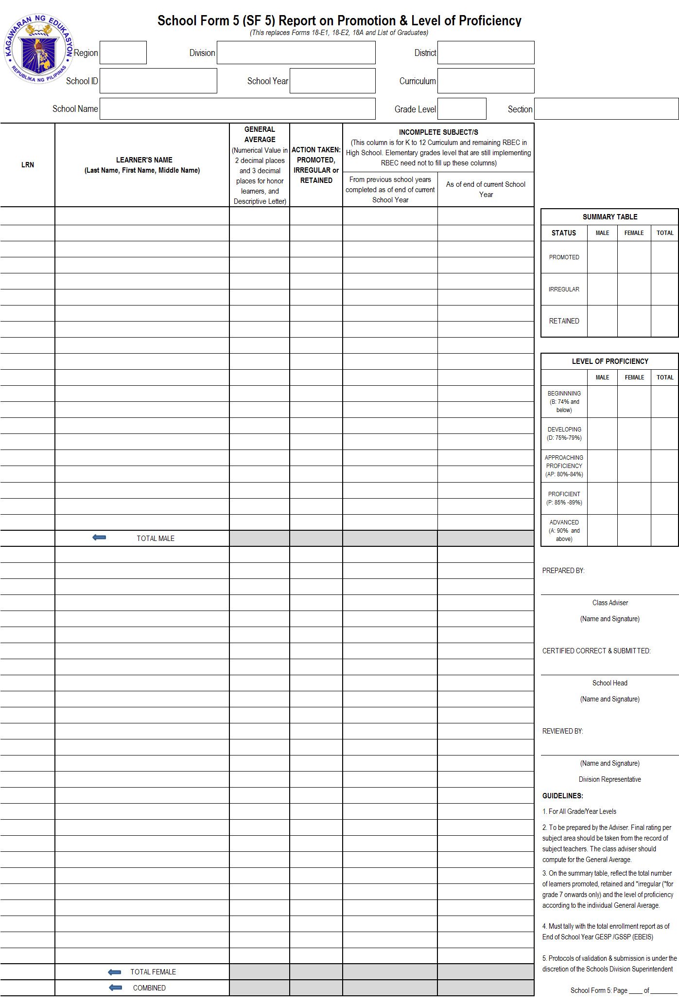
School Form 5 (SF5) Report on Promotion & Level of Proficiency (This replaces Form 18-E1, 18-E2, 18 A and List of Graduates)

Slide 10
SCHOOL FORMS Data Element Descriptions SF 5- Report on Promotion & Level of Proficiency
 | DATA ELEMENT | DESCRIPTION
1 | School ID | A six (6) digit-number assigned to a school recognized in EBEIS
2 | Curriculum | Systematic group of experiences or sequences of courses or subject required for graduation or certification in each level of education. For Grade levels implementing K to 12 Basic Education Curriculum, “K to12 BEC” will be reflected. For the remaining grade/year level, “Restructured BEC” will be written.
3 | School Year | The prescribed period of time when schools offer daily instruction. It covers10 months of regular schooling starting month of June (Beginning of School Year) up to the month of March (End of School Year) of the following year.

Slide 11
SCHOOL FORMS Data Element Descriptions SF 5- Report on Promotion & Level of Proficiency
 | DATA ELEMENT | DESCRIPTION
4 | School Name | Official name of school as registered in DepED and EBEIS
5 | Grade Level | A degree/stage of a learner classified according to age and progress.
6 | Section | A group of pupils/students convened together to receive instruction in a given course or subject.
7 | Learner Reference Number (LRN) | Twelve (12)-digit number which the pupil, student or learner shall keep while completing the basic education program, regardless of transfer to another school or learning center in the public or private sector, and promotion/moving up to the secondary level. (DO22, s.2012)

Slide 12
SCHOOL FORMS Data Element Descriptions SF 5- Report on Promotion & Level of Proficiency
 | DATA ELEMENT | DESCRIPTION
8 | Learner's Name | Name of an individual as reflected in birth certificate or equivalent document.
9 | General Average | The average rating of a student in all subject areas taken in a given school year written in a numerical value of 3 decimal places for honor students and two for non-honors. Equivalent Descriptive Letter Value should be written in close parenthesis. Leave this column blank for irregular learners or learners with subject deficiencies.

Slide 13
SCHOOL FORMS Data Element Descriptions SF 5- Report on Promotion & Level of Proficiency
 | DATA ELEMENT | DESCRIPTION
10 | Action Taken | Status of Learner as of End of School Year using the following categories: Promoted: Satisfied requirements in all subject areas Irregular: with incomplete subject/s. This category implies that the learner is promoted to the next level but with deficiencies in one or more subject area/s. (as of SY2012-2013, this particular status is applicable only to Grade 7 onwards) Retained: Learner who was not able to complete even one subject area.

Slide 14
SCHOOL FORMS Data Element Descriptions SF 5- Report on Promotion & Level of Proficiency
 | DATA ELEMENT | DESCRIPTION
11 | Incomplete Subject/s (Completed as of end of current SY) | The subject area from the previous level taken by the student in the current school year because of previous subject deficiency that he/she has passed in the current SY. This column is for K To 12 Curriculum and remaining RBEC in high school.
12 | Incomplete Subject/s as of End of the current SY | The subject/s currently undertaken by the learner for the current School Year but failed to pass. This column is for K To 12 Curriculum and remaining RBEC in high school.

Slide 15
SCHOOL FORMS Data Element Descriptions SF 5- Report on Promotion & Level of Proficiency
 | DATA ELEMENT | DESCRIPTION
13 | Summary Table - Promoted (Male/Female/Grand Total) | The no. of learners (male/female/grand total) who are promoted to the next grade level for the next school year.
14 | Summary Table - Irregular (Male/Female/Grand Total) | The no. of learners (male/female/grand total) who are promoted to the next grade level for the next school year but with deficiency in some subjects. (Applicable only to K to 12 Curriculum-Grade 7 onwards)
15 | Summary Table - Retained (Male/Female/Grand Total) | The no. of learners (male/female/grand total) retained in the same grade level for the next school year.

Slide 16
SCHOOL FORMS Data Element Descriptions SF 5- Report on Promotion & Level of Proficiency
 | DATA ELEMENT | DESCRIPTION
16 | Level of Proficiency- Beginning (Male/Female/Grand Total) | The no. of learners (male/female/grand total) who are at the beginning level or whose numerical grade is 74% and below.
17 | Level of Proficiency- Developing (Male/Female/Grand Total) | The no. of learners (male/female/grand total) who are at the developing level of proficiency or has numerical grade ranges from 75% to 79%.
18 | Level of Proficiency- Approaching (Male/Female/Grand Total) | The no. of learners (male/female/grand total) who are at the approaching level of proficiency or whose numerical grade ranges from 80% to 84%.
19 | Level of Proficiency- Proficient (Male/Female/Grand Total) | The no. of learners (male/female/grand total) who are at the proficient level of proficiency or whose numerical grade ranges from 85% to 89%.

Slide 17
SCHOOL FORMS Data Element Descriptions SF 5- Report on Promotion & Level of Proficiency
 | DATA ELEMENT | DESCRIPTION
20 | Level of Proficiency- Advanced (Male/Female/Grand Total) | The no. of learners (male/female/grand total) who are at the advance level of proficiency or whose numerical grade is 90% and above.
21 | Name and signature of the Class Adviser | The name and signature of the teacher who prepared this form.
22 | Name and signature of the School Head | The name and signature of the school head attesting the veracity of this form.

Slide 18
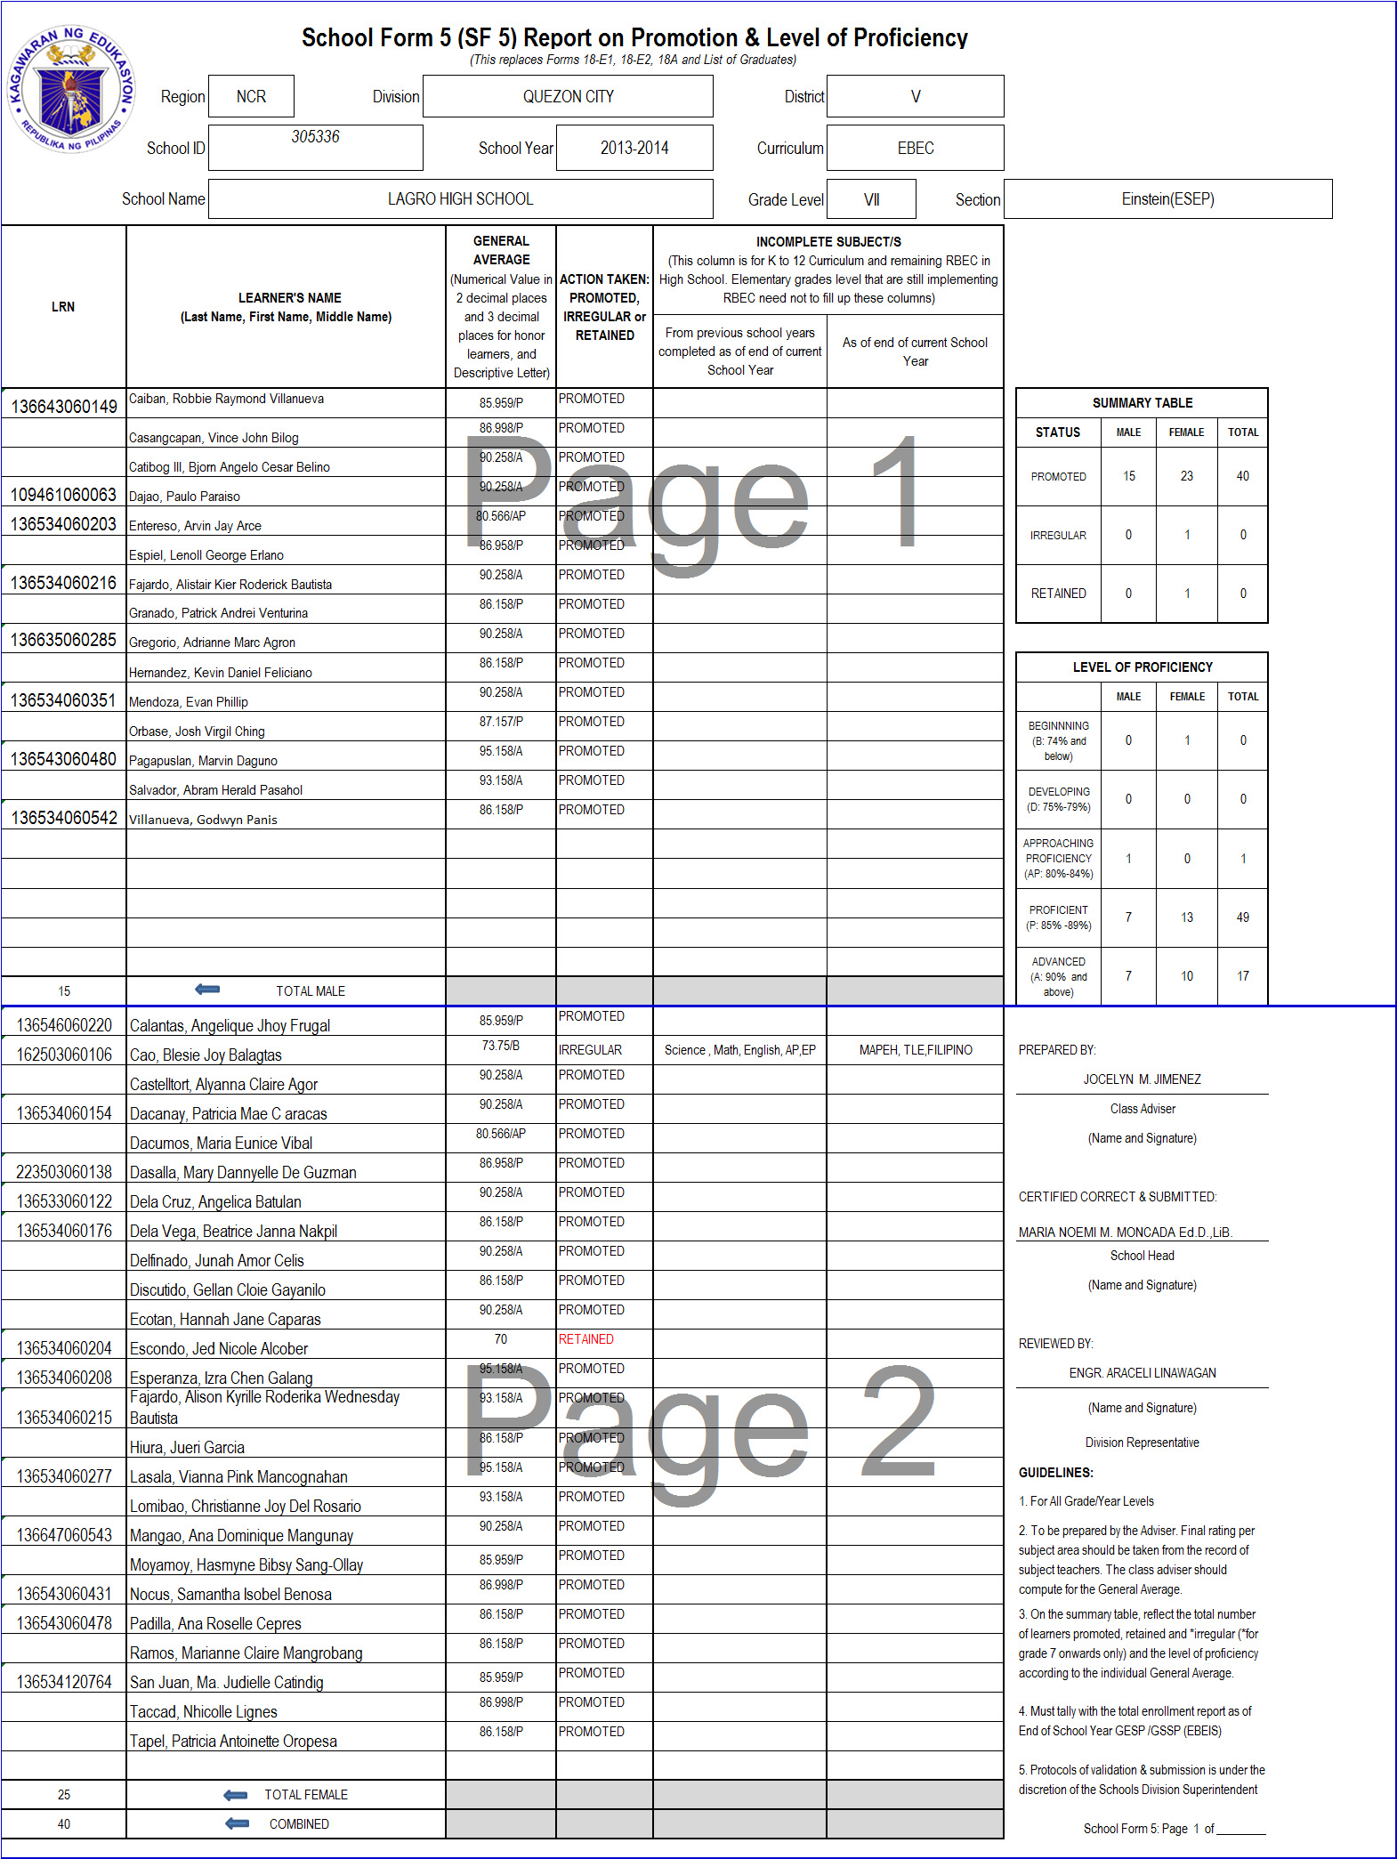

Slide 19
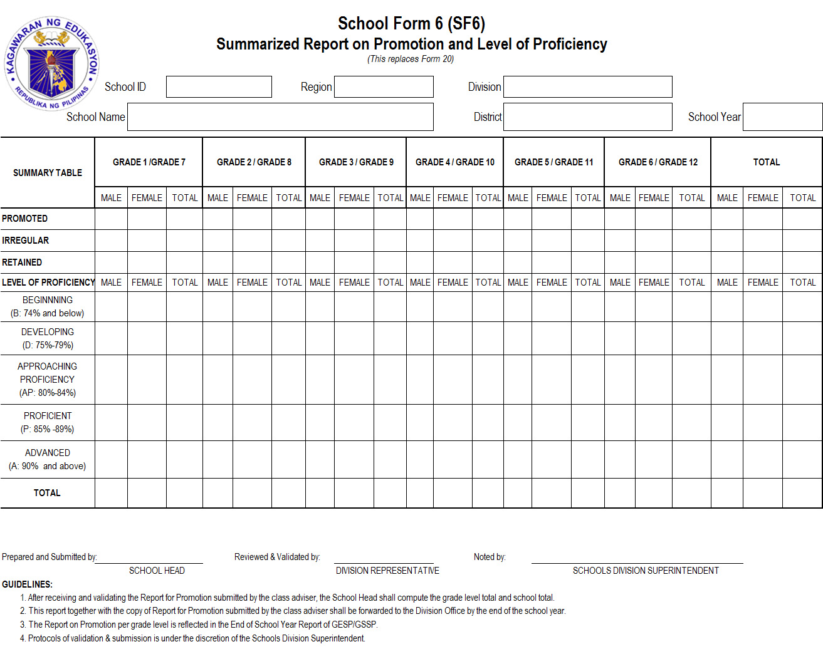
School Form 6(SF6) Summarized Report on Promotion & Level of Proficiency (This replaces Form 20)

Slide 20
SCHOOL FORMS Data Element Descriptions SF 6- Summarized Report on Promotion and Level of Proficiency
 | DATA ELEMENT | DESCRIPTION
1 | School ID | A six (6) digit-number assigned to a school recognized in EBEIS
2 | School Year | The prescribed period of time when schools offer daily instruction. It covers10 months of regular schooling starting month of June (Beginning of School Year) up to the month of March (End of School Year) of the following year.
3 | School Name | Official name of school as registered in DepED and EBEIS
4 | Promoted (Male/Female/Grand Total) | Total no of learners (male/female/grand total) in a certain grade level who are promoted for the next grade level for the next school year.

Slide 21
SCHOOL FORMS Data Element Descriptions SF 6- Summarized Report on Promotion and Level of Proficiency
 | DATA ELEMENT | DESCRIPTION
5 | Irregular (Male/Female/Grand Total) | Total no. of learners (male/female/grand total) who are promoted to the next grade level for the next school year but with deficiency in some subject. (Applicable only to K-12 Curriculum)
6 | Retained (RBEC) (Male/Female/Grand Total) | Total no. of learners (male/female/grand total) in a certain grade level retained in the same grade level for the current school year.
7 | Level of Proficiency Beginning (Male/Female/Grand Total) | Total no of learners (male/female/grand total) in a certain grade level who are in the beginning level of proficiency.
8 | Level of Proficiency Developing (Male/Female/Grand Total) | Total no. of learners (male/female/grand total) in a certain grade level who are in the developing level of proficiency.

Slide 22
SCHOOL FORMS Data Element Descriptions SF 6- Summarized Report on Promotion and Level of Proficiency
 | DATA ELEMENT | DESCRIPTION
9 | Level of Proficiency Approaching (Male/Female/Grand Total) | Total no. of learners (male/female/grand total) in a certain grade level who are in the approaching level of proficiency.
10 | Level of Proficiency Proficient Male/Female/Grand Total) | Total no. of learners (male/female/grand total) in a certain grade level who are in the proficient level of proficiency.
11 | Level of Proficiency Advanced (Male, Female, Grand Total) | Total no. of learners (male/female/grand total) in a certain grade level who are in the advanced level of proficiency.

Slide 23
SCHOOL FORMS Data Element Descriptions SF 6- Summarized Report on Promotion and Level of Proficiency
 | DATA ELEMENT | DESCRIPTION
12 | Name and Signature of School Head | The name and signature of the school head who prepared this form.
13 | Name and Signature of DPO/EPS | The name and signature of the Division's Planning Officer or EPS who reviewed and validated this form.
14 | Name and Signature of Schools Division Superintendent | The name and signature of the Schools Division Superintendent attesting the veracity of this form.

Slide 24
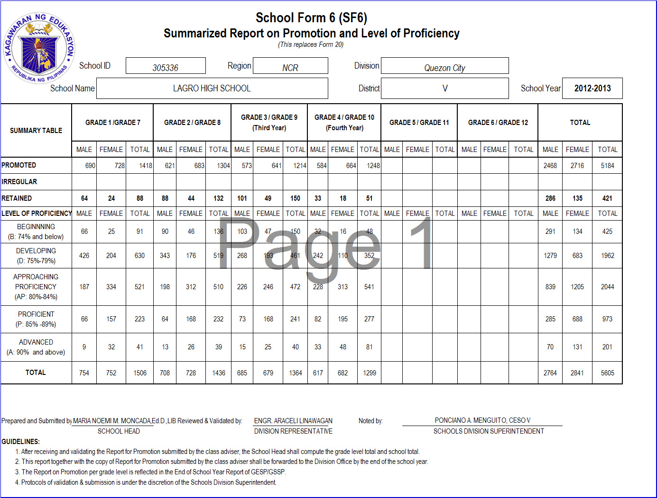

Slide 25
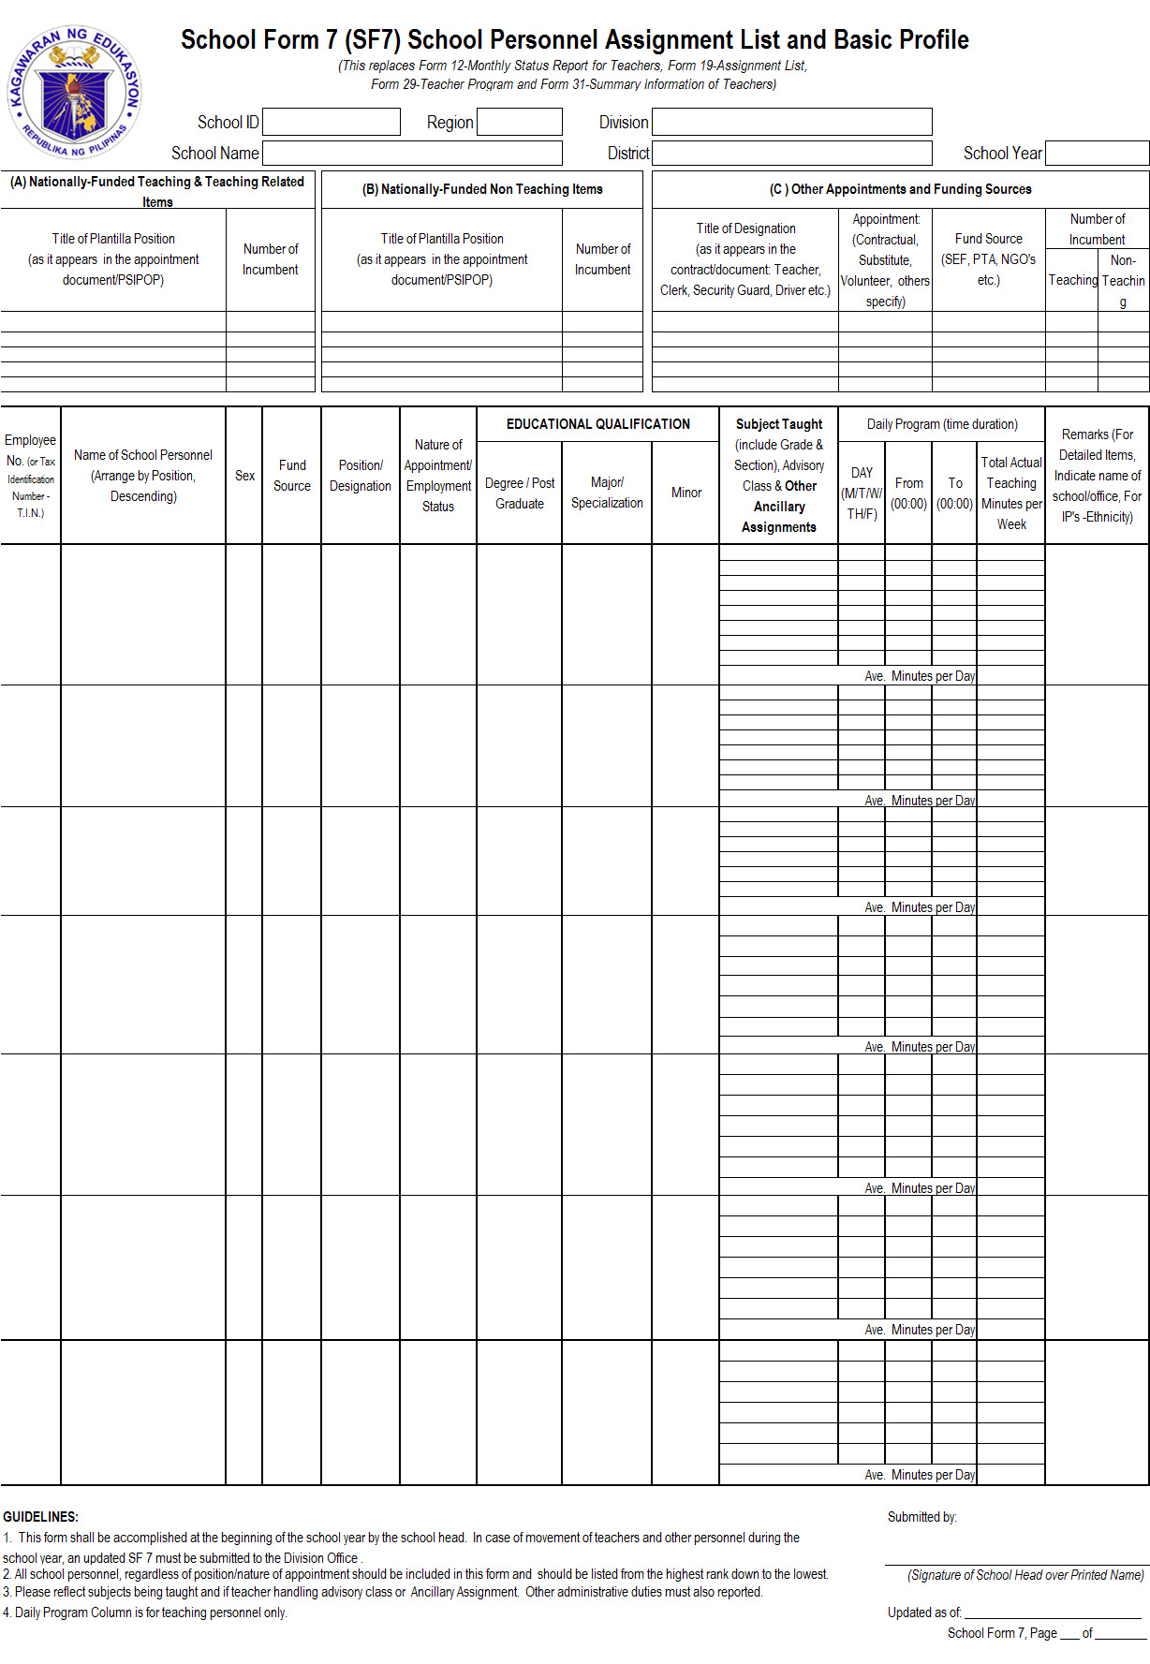
School Form 7(SF7) School Personnel Assignment List and Basic Profile (This replaces Form 12- Monthly Status Report for Teachers, Form 19-Assignment List, Form 29-Teacher Program and Form 31-Summary Information of Teachers)

Slide 26
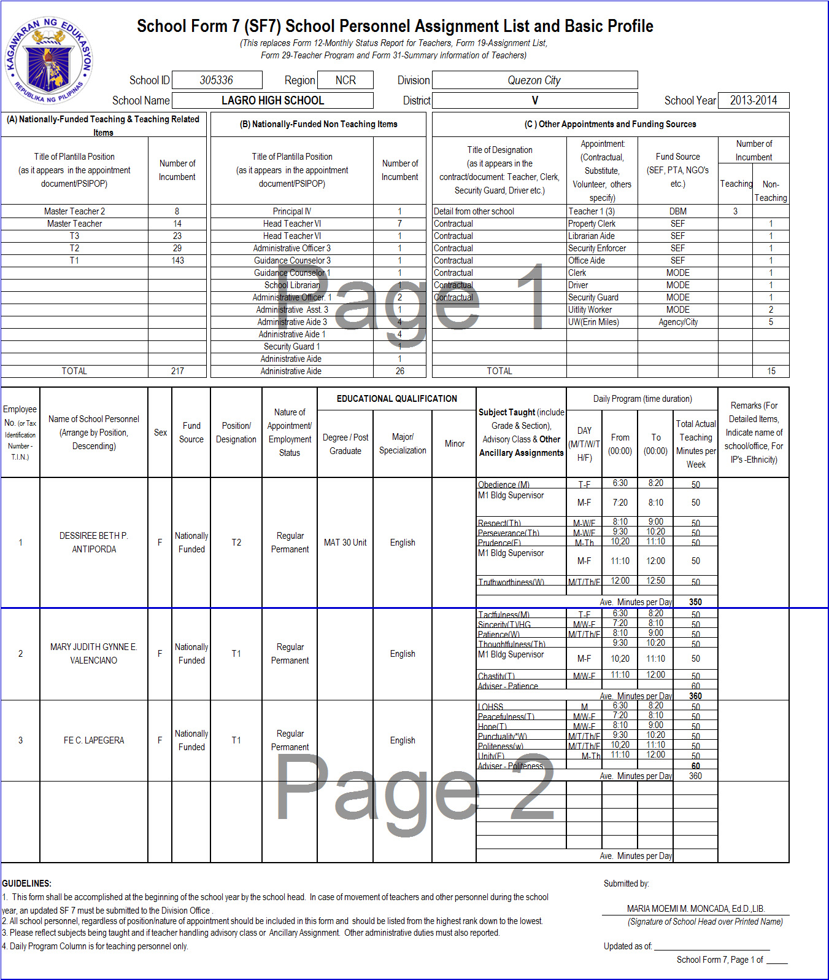

Slide 27
SCHOOL FORMS Data Element Descriptions SF 7- School Personnel Assignment List and Basic Profile
 | DATA ELEMENT | DESCRIPTION
1 | School ID | A six (6) digit- number assigned to a school recognized in EBEIS
2 | School Year | The prescribed period of time when schools offer daily instruction. It covers10 months of regular schooling starting month of June (Beginning of School Year) up to the month of March (End of School Year) of the following year.
3 | School Name | Official name of school as registered in DepED and EBEIS

Slide 28
SCHOOL FORMS Data Element Descriptions SF 7- School Personnel Assignment List and Basic Profile
 | DATA ELEMENT | DESCRIPTION
4 | (A) Nationally Funded Teaching Related Items (Summary Table) Title of Plantilla Position | Teaching and teaching-related plantilla positions including those with provisional appointments. Title of Plantilla as reflected in the PSI-POP and/or appointment (generic, where applicable). (Only Personnel actually reporting to the school are to be included.
5 | Number of Incumbent | The total number of personnel occupying the said Plantilla Position.

Slide 29
SCHOOL FORMS Data Element Descriptions SF 7- School Personnel Assignment List and Basic Profile
 | DATA ELEMENT | DESCRIPTION
6 | (B) Nationally-Funded Non-Teaching Items | Non-Teaching Plantilla positions approved by the Department of Budget and Management (DBM) whose positions are not engaged in classroom teaching but assist in the delivery of services such as Administrative, Personnel, Supply, Records, Accounting and other support roles in the school. Title of Plantilla as reflected in the PSI-POP and/or appointment (generic, where applicable). (Only Personnel actually reporting to the school are to be included.

Slide 30
SCHOOL FORMS Data Element Descriptions SF 7- School Personnel Assignment List and Basic Profile
 | DATA ELEMENT | DESCRIPTION
7 | (C ) Other Appointments and Funding Sources | Title of Designation and Nature of Appointment Designation as reflected in the contract or other related document -Teacher, Clerk, Driver etc.; Nature of Appointment or Employment Status refers to Contractual, Substitute, Casual/Emergency, Job Order/Contract of Service, Volunteer, etc. In accomplishing this column, the designation title will be reflected first before the nature of appointment. (Example: Teacher – Contractual)

Slide 31
SCHOOL FORMS Data Element Descriptions SF 7- School Personnel Assignment List and Basic Profile
 | DATA ELEMENT | DESCRIPTION
8 | Number of Teaching & Non Teaching Incumbent/s | The total number of teaching and non-teaching incumbents who are not holding plantilla / regular position
9 | Number of Teaching & Non Teaching Incumbent/s | The total number of teaching and non-teaching incumbents who are not holding plantilla / regular position

Slide 32
SCHOOL FORMS Data Element Descriptions SF 7- School Personnel Assignment List and Basic Profile
 | DATA ELEMENT | DESCRIPTION
9 | Name of Personnel | Employee’s complete name (Last Name, First Name, Middle Name, Name Extension) as reflected in their birth/baptismal certificate. (Arrange descending by Position)
10 | Sex | Employee’s sex as reflected in the birth/baptismal certificate
11 | Fund Source | Name of the institution or source that finances the employment of the particular employee. Use “National” For Plantilla item positions. Other fund sources may be SEF Provincial, SEF Municipal, LGU, PTA, NGO (specify) and others (specify)

Slide 33
SCHOOL FORMS Data Element Descriptions SF 7- School Personnel Assignment List and Basic Profile
 | DATA ELEMENT | DESCRIPTION
12 | Position/Designation | The official item or position assigned to an employee as reflected in the appointment paper, contract or equivalent document signed by the approving authority.
13 | Nature of Appointment/Employment Status | Each employee may either be any of the following : Permanent : a permanent appointment shall be issued to a person who has met all requirements of the position including the prescribed civil service eligibility. Temporary : issued to a person who meets the education, experience and training requirements for the position to which he/she is being appointed , except the appropriate eligibility. Substitute: when the regular incumbent of a position is temporarily unable to perform the duties of the position, as when he/she is on approved leave of absence, suspension, scholarship grant or secondment. A substitute appointment is issued only if the leave of absence of the incumbent is at least three (3) months except in the case of teachers.

Slide 34
SCHOOL FORMS Data Element Descriptions SF 7- School Personnel Assignment List and Basic Profile
 | DATA ELEMENT | DESCRIPTION
13 | Nature of Appointment/Employment Status | Coterminous status : issued to a person whose entrance and continuity in the service is: Based on the trust and confidence of the appointing authority or head of unit; Co-existent with the incumbent; Limited by the duration of the project; Co-existent with the appointee; Appointments of personnel under the Foreign-Assisted Projects (FAP) shall be co-terminus with the project. Contractual : issued to a person who shall undertake specific work or job for a limited period of time not to exceed one (1) year Casual/Emergency: used only for essential and necessary services where there are not enough regular staff to meet the demands of the service. These are normally emergency laborers hired for a period not exceeding six (6) months. *Job Order/Contract of Service * Volunteer

Slide 35
SCHOOL FORMS Data Element Descriptions SF 7- School Personnel Assignment List and Basic Profile
 | DATA ELEMENT | DESCRIPTION
14 | Educational Qualification – Degree/ | Highest Educational Attainment
 | Post-graduate
15 | Educational Qualification – Major | Area of Specialization/field of study or specialized training
16 | Educational Qualification – Minor

Slide 36
SCHOOL FORMS Data Element Descriptions SF 7- School Personnel Assignment List and Basic Profile
 | DATA ELEMENT | DESCRIPTION
19 | Subject Taught (include Year & Section) Advisory Class & Other Assignment (Please Specify) | Indicate subject areas being taught (include administrative/ancillary assignment if any). Advisory class must be included in reporting teacher’s assignment. Assignment of non-teaching personnel shall also reflect in this column.
20 | Daily Program (time duration) – From / to | For Teachers only. This is the daily schedule of the teacher for the subject areas he/she handles on a weekly basis. Total assigned teaching minutes per week for each subject area must be reflected.

Slide 37
SCHOOL FORMS Data Element Descriptions SF 7- School Personnel Assignment List and Basic Profile
 | DATA ELEMENT | DESCRIPTION
19 | Average Teaching Minutes per Day | Add the total number of minutes per day for each subject area and divide by 5 days.
20 | Remark/s (For Detailed Items, indicate name of school/office) | Particular information about the personnel (IP, Detailed or other specific information required in the EBEIS/HRIS)
21 | Name and Signature of School Head | The name and signature of the school head who prepared this form.

